Slide 1
ANZ Metadata working Group – Meeting 4
AODN Portal and future plans for Metadata
Natalia Atkins
13th June 2019

Slide 2
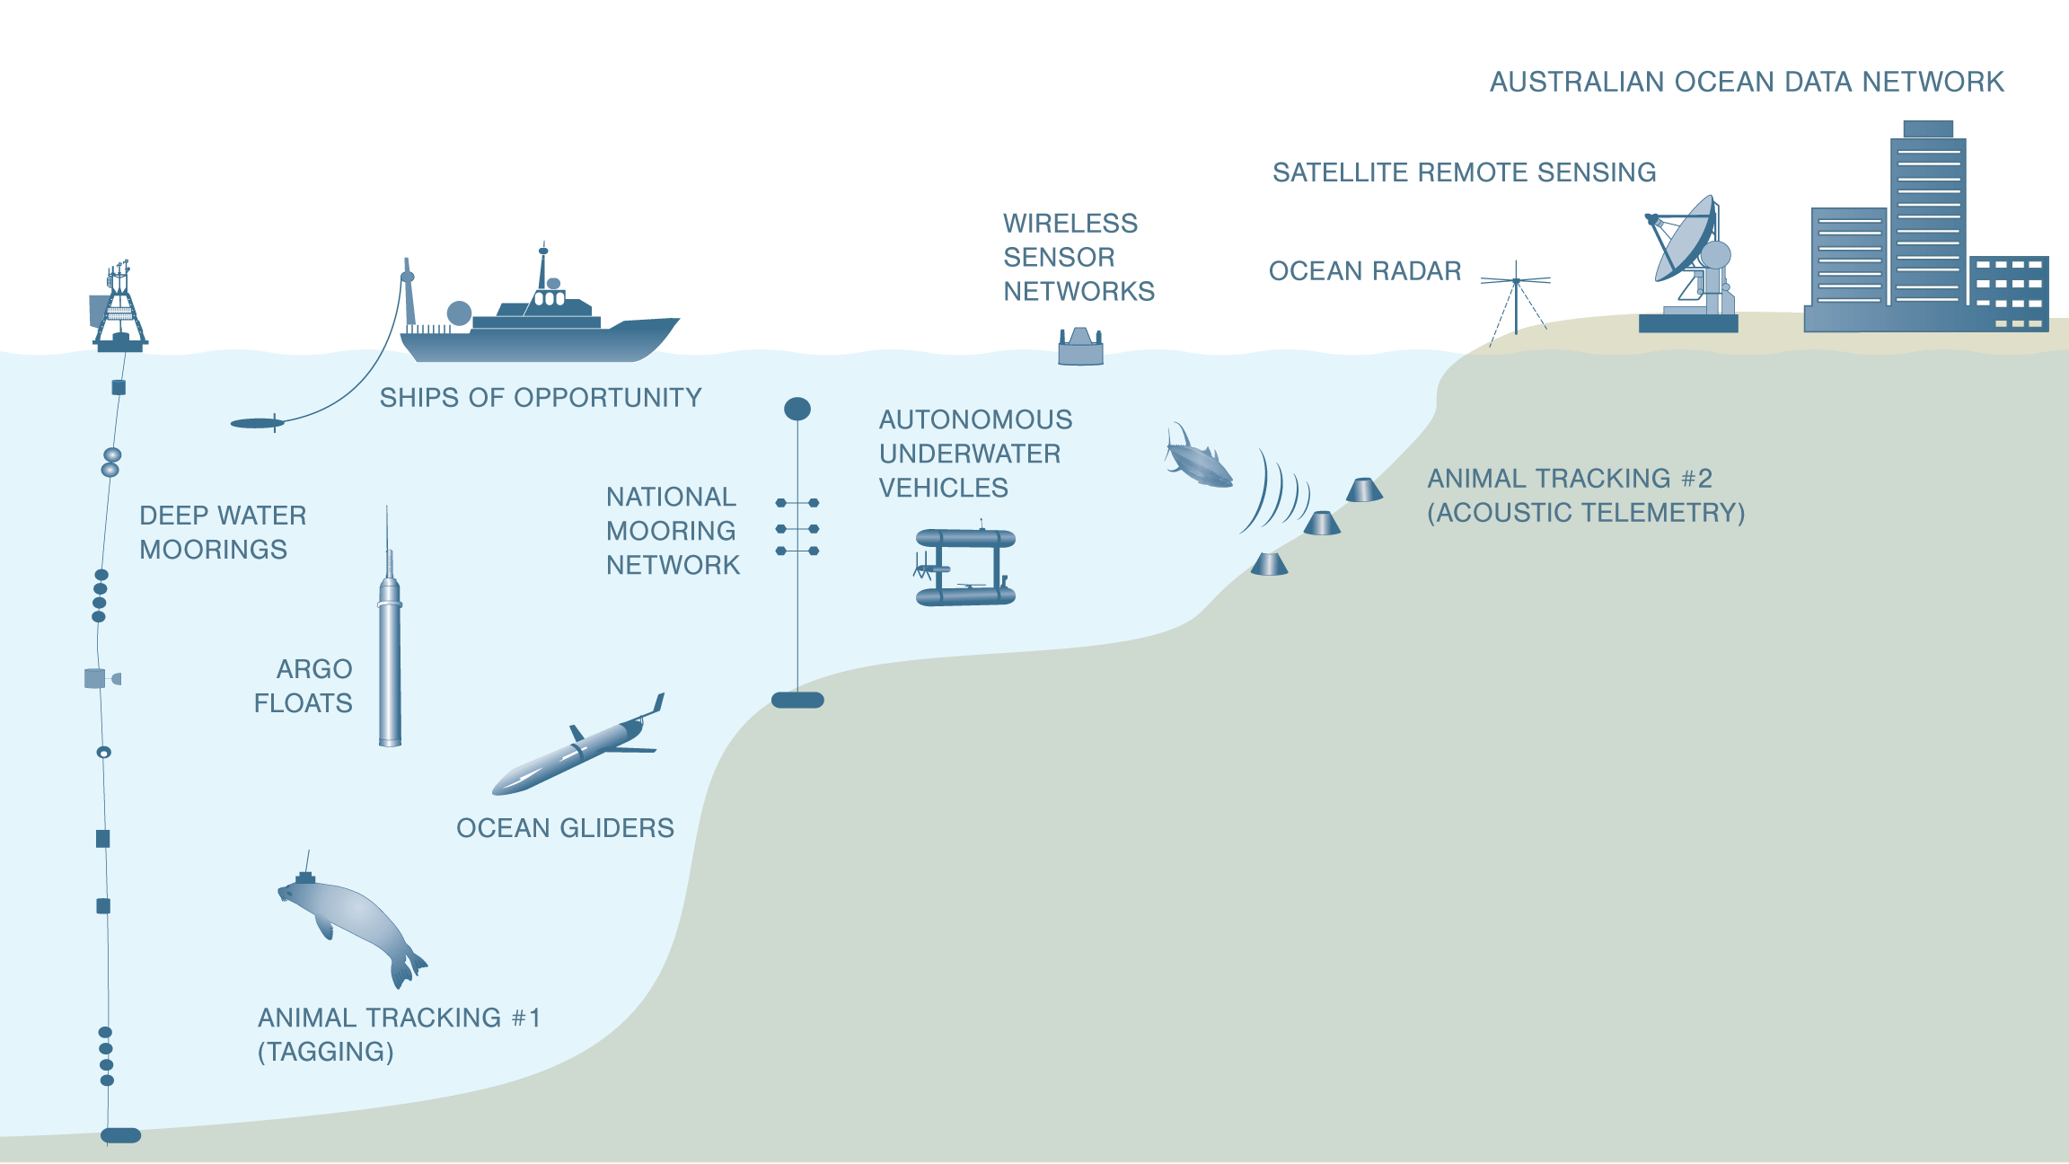
IMOS Facilities
All data collected is discoverable, freely and openly accessible, usable and reusable
Notes:
11 facilities - across disciplines and scales

Slide 3
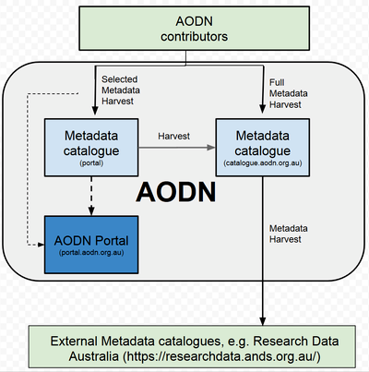
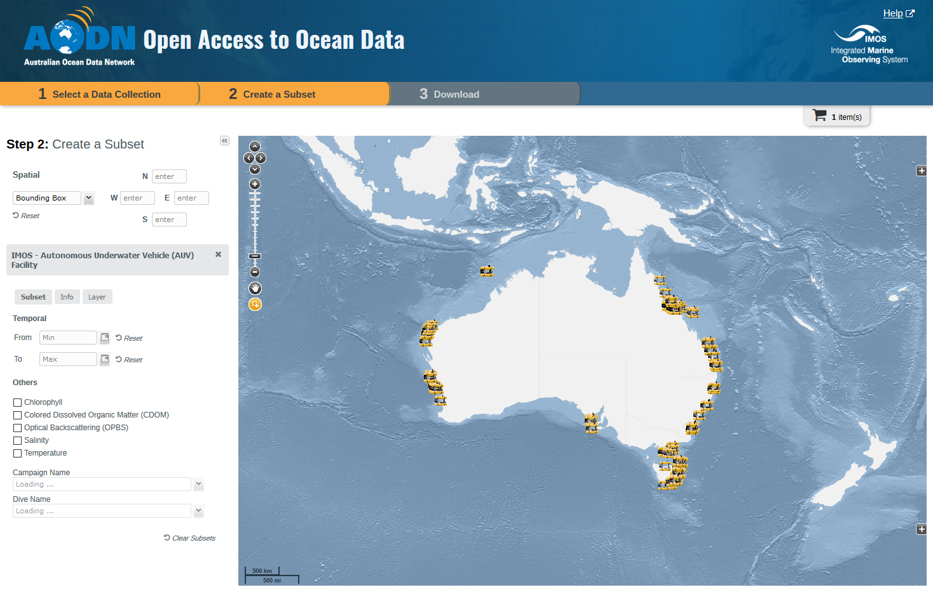
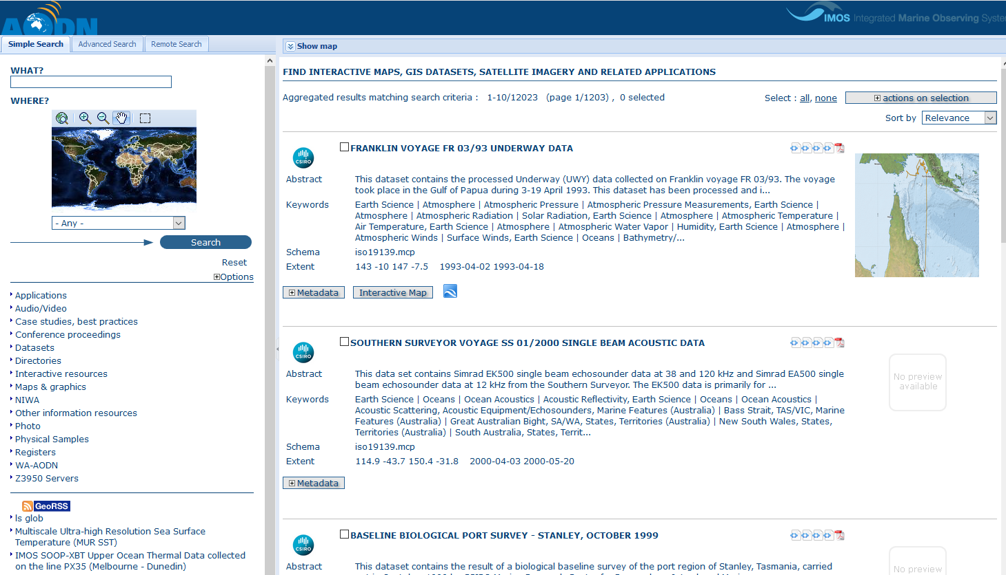
What does it mean to publish data to the AODN?

Slide 4
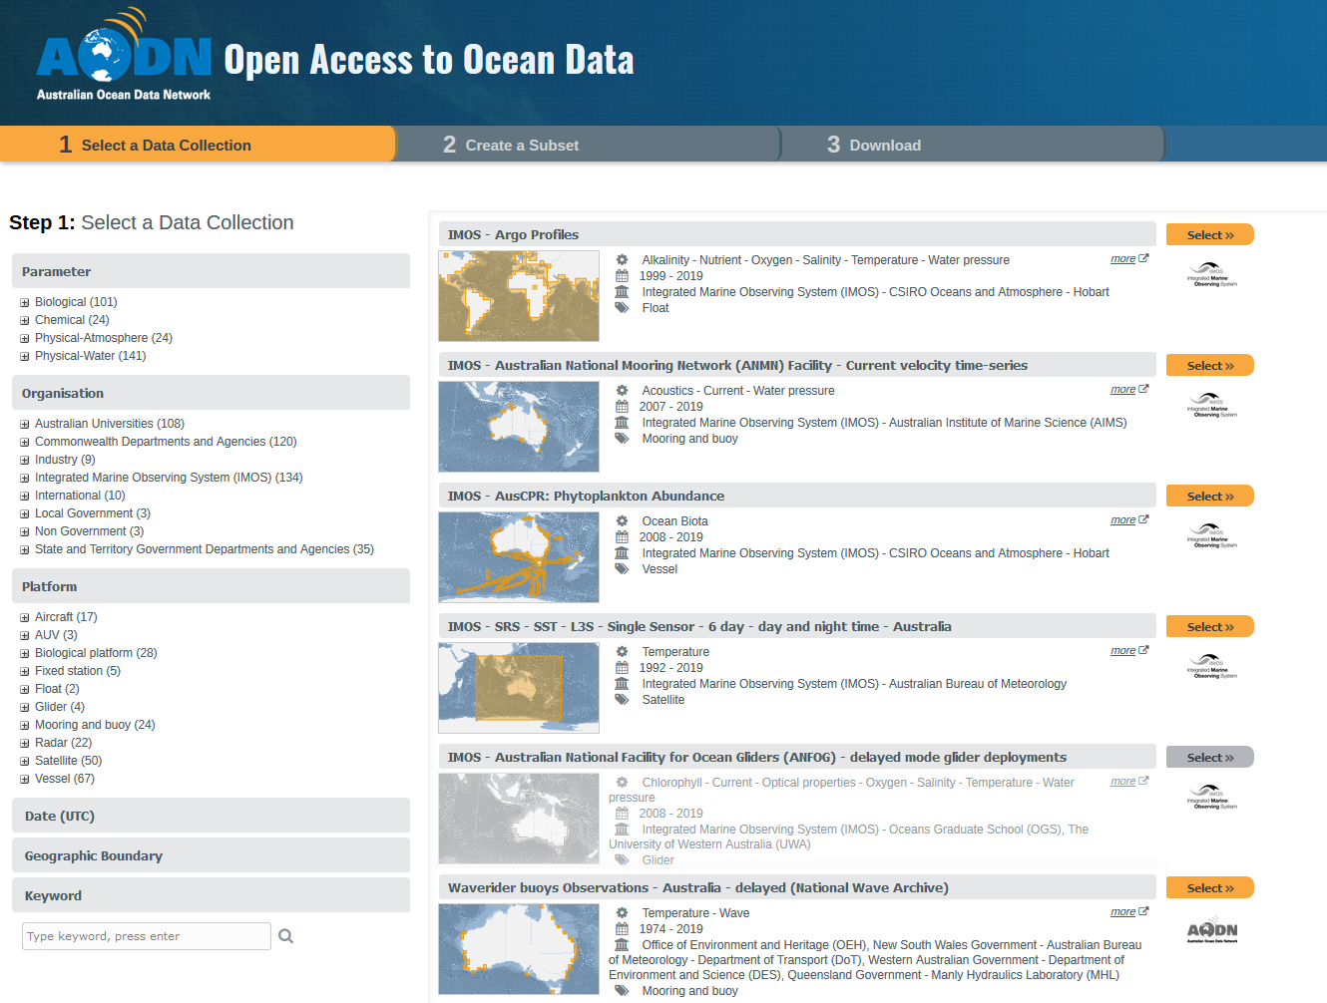
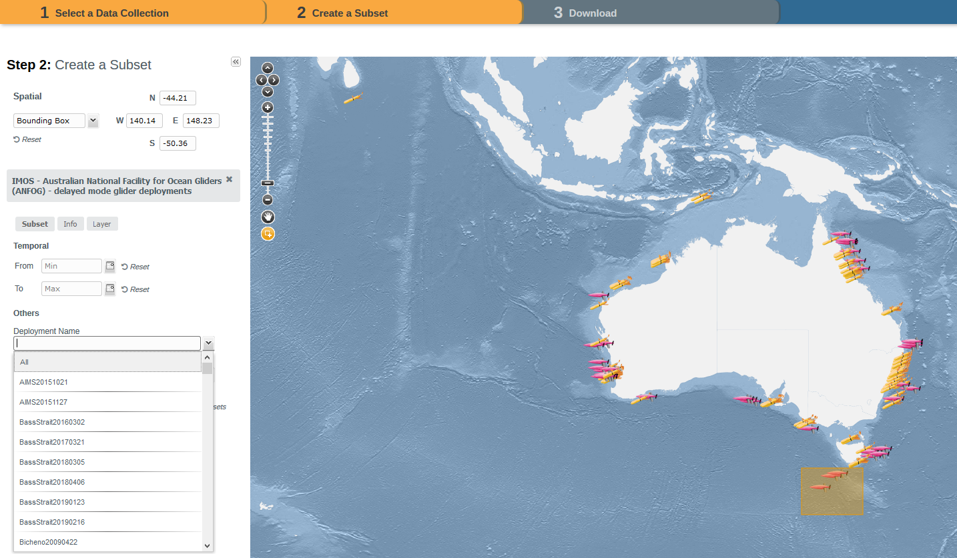
AODN Portal (https://portal.aodn.org.au)

Slide 5
AODN Portal

Slide 6
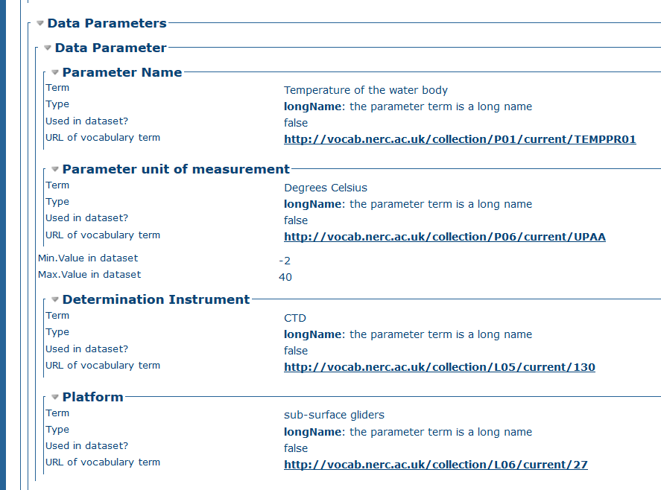
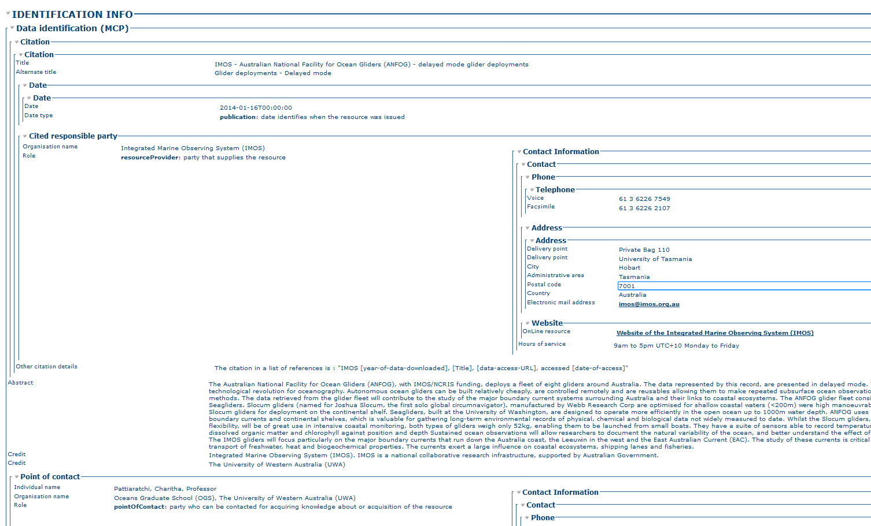
GeoNetwork (2.10)

Slide 7
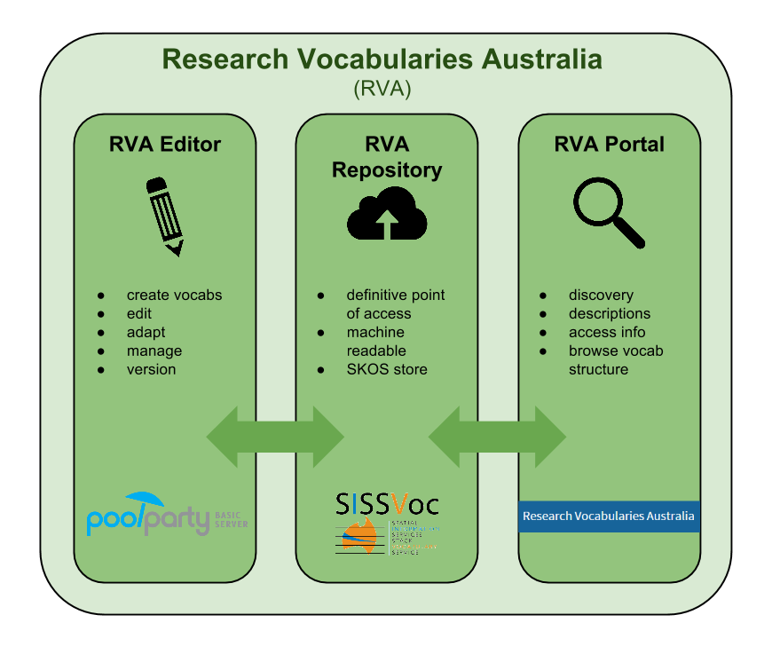
&

Slide 8
AODN published vocabularies on RVA
Units of Measure
63 concepts
Version 1.0
Re-uses terms from BODC P06
Platform
425 concepts
Version 3.5
Re-uses terms from BODC L06 and C17
XBT Line
134 concepts
Version 1.0
Instrument
272 concepts
Version 2.1
Re-uses terms from BODC L05 and L22
Organisation
533 concepts
Version 2.0
Many mapped to EDMO
Discovery parameter
204 concepts
Version 1.4
Many mapped to BODC P01
Geographic Extents
305 concepts
Version 2.0

Slide 9
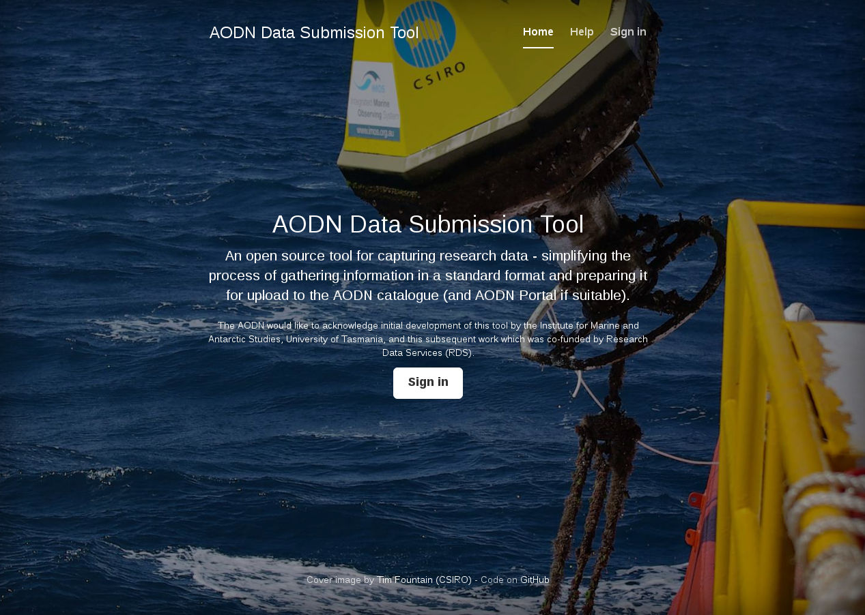
AODN metadata entry tool
(https://metadataentry.aodn.org.au/submit/)

Slide 10
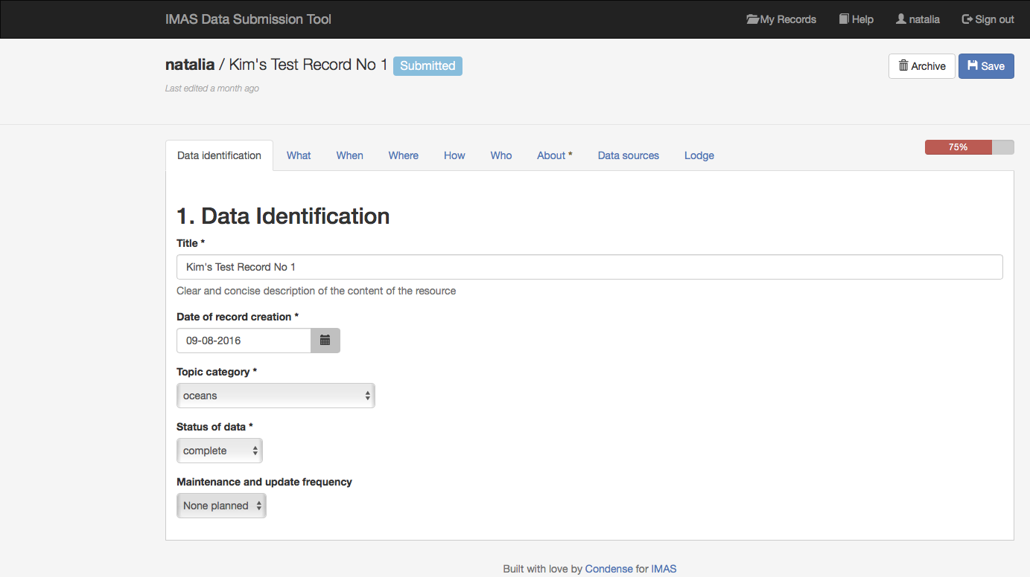
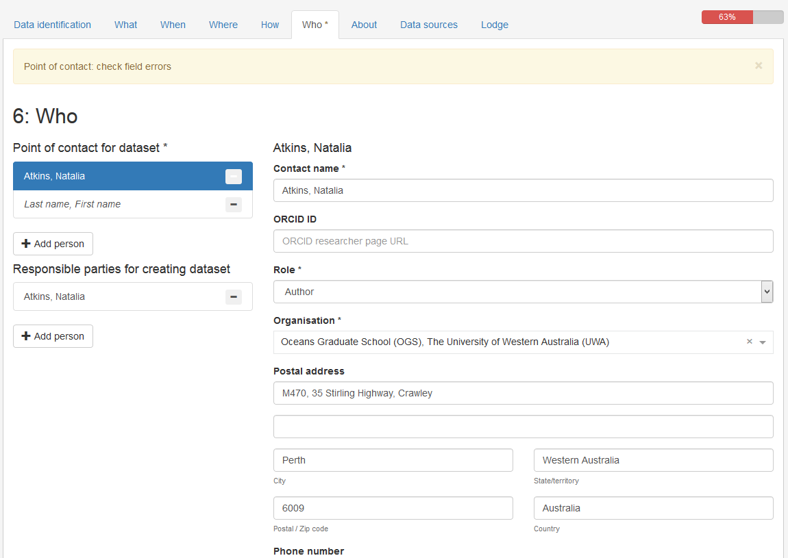
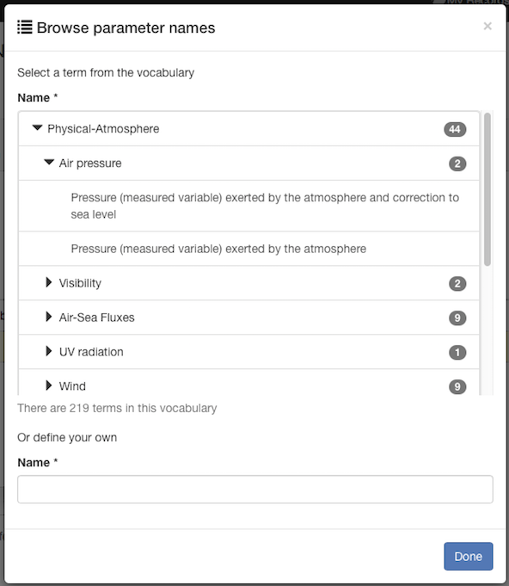
AODN metadata entry tool
Periodically refreshed from SPARQL endpoint

Slide 11
Marine Community Profile of ISO 19115:2005/19139
extended ISO 19115 to include new elements and customised codelists to meet the needs of the marine community
First devised by Australian Oceanographic Data Centre Joint Facility (AODCJF) in 2006
One of the first implementations was part of the BlueNet Project (2007)
Version 1.4 >2.0 due to the Portal (2015)
Plans to move to ISO 19115-1
Upgrading Geonetwork to the latest stable version in combination with the transition from MCP 2.0 to ISO 19115-1
To be completed by the end of next Financial Year

Slide 12
Issues with moving to ISO 19115-1
Internal dependencies
multiple metadata catalogues
AODN metadata entry tool
External dependencies
harvesting from external sources
RDA harvest of IMOS and AODN catalogues
Which of our Portal dependent elements are MCP 2.0 dependent?
Data Parameter
Temporal Extent > temporalAggregationPeriod (not currently used)
Resource constraints > License information (Creative Commons)
We would need a Guidelines/Best Practice document

