Slide 1
Update on OGC, ISO and UNGGIM work
Chris Body
1 June 2022

Slide 2
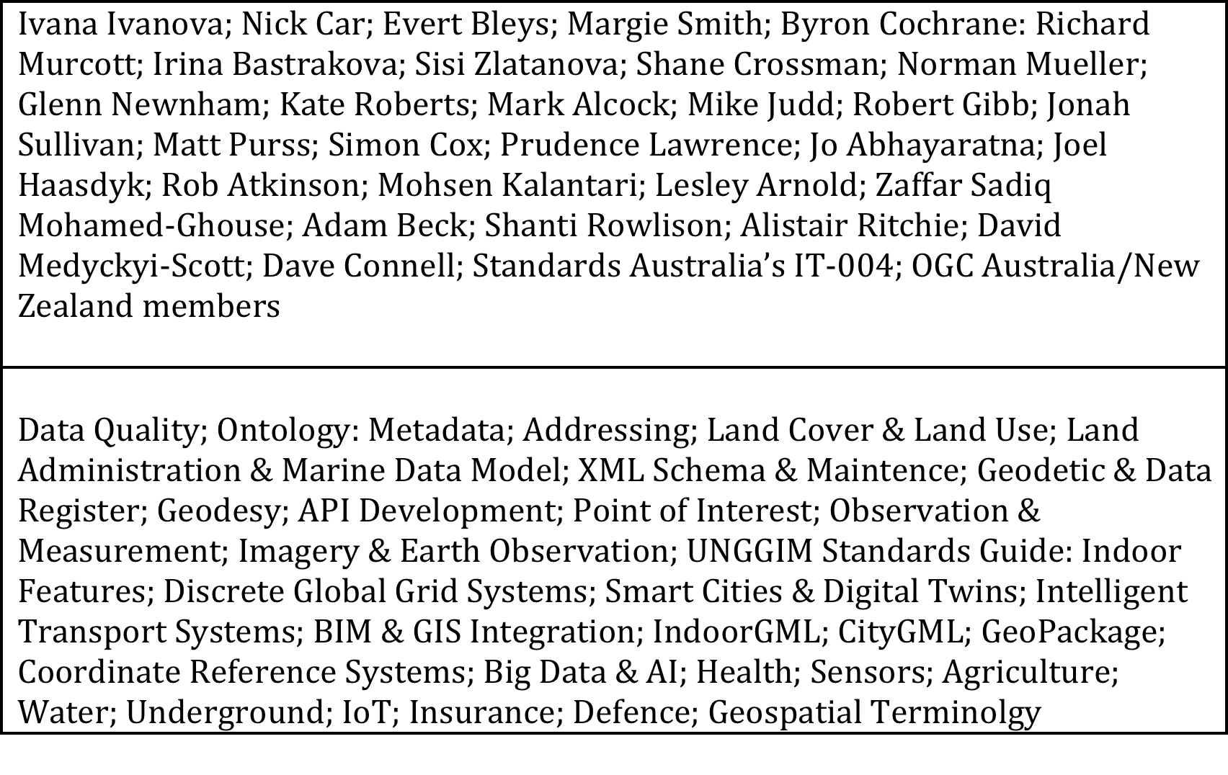
Australian/New Zealand Contributors/Topics

Slide 3
ICSM Work Program
3D Cadastral Survey Data Model and Exchange Project
Addressing
Assist with GDA2020 Implementation
Cadastre
Develop and Maintain the Australian Geospatial Reference System
Elevation and Depth Data
Elevation, Depth and Imagery Working Group
Foundation Spatial Data Framework’s Location Information Knowledge Platform
Geodesy
Metadata Working Group
Place Names
Tides and Mean Sea Level
Topographic Information

Slide 4
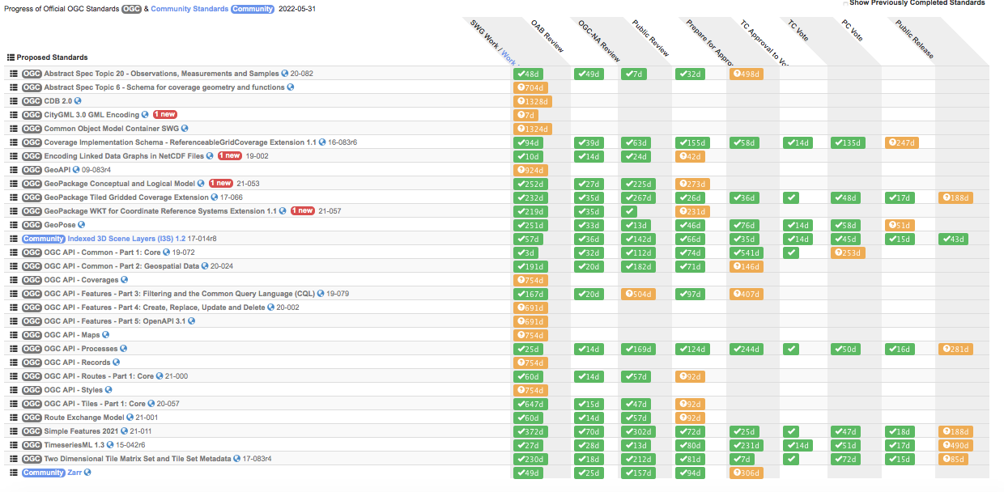
OGC Standards Current Program

Slide 5
OGC Meeting
13-17 June 22, Madrid, Spain
Metaverse is Geospatial
MetaCat DWG
OGC API Maps
Architecture DWG
Emergency and Disaster Management DWG
POI SWG
OGC API Tiles
CityGML SWG
Digital Twins
Data Quality DWG
Point Cloud DWG
Coverages SWG
https://portal.ogc.org/meet/

Slide 6
ISO/TC 211
ISO/TC 211
  ISO/TC 211 Website – https://committee.iso.org/home/tc211
  ISO/TC 211 Last Meeting Highlights:
    New Chair – Peter Parslow (UK-OS)
    Collaborating with other Standards Committees on ITS, Digital Twin, Sustainable Cities & Communities, BIM
    Registries & Semantics to improve data management within ISO/TC 211 & ISO
  ISO/TC 211 Next Meeting, 6-9 Dec, Stockholm – https://committee.iso.org/sites/tc211/home/plenary-meeting/55th-plenary-meeting-stockholm.html

Slide 7
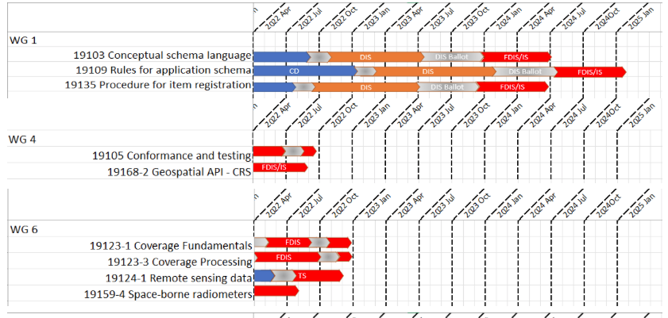
ISO/TC 211 Current Work Program

Slide 8
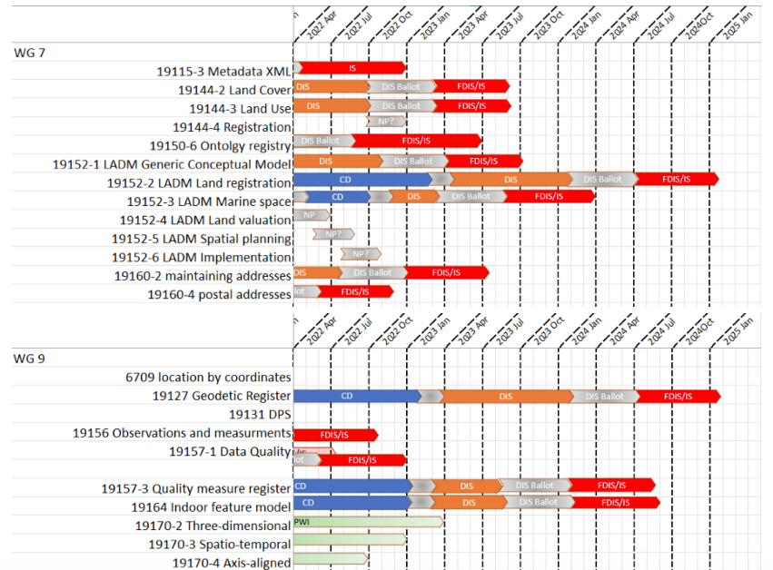
ISO/TC 211 Current Work Program

Slide 9
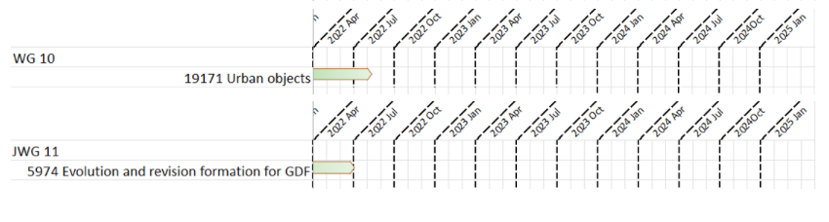
ISO/TC 211 Current Work Program

Slide 10
Supporting Programs
Land Administration Domain Model
  Multi-part covering – Land Administration; Marine Georegulation: Valuation; Spatial Planning; Conceptual Model and Roadmap for Implementation
Land Cover & Land Use
  Support the new versions; FAO and UN programs & reports; Australia is provided feedback
UNGGIM Standards Guide
    http://standards.unggim.ogc.org/index.php

Slide 11
Supporting Programs
GIS & BIM Integration
  Links with IndoorGML and CityGML
ISO Geodetic Register
  Migrating to a new platform to allow future registers
  Drafting proposal for UNGGIM-Global Geodetic Centre of Excellence to become the new Registration Agency
  Collaboration with IOGP & OGC
API Developments
  OGC Tiles & OGC Records

Slide 12
International Supporting Programs
International Programs
  United Nations Sustainable Development Goals
  United Nations Global Geodetic Reference Frame
  United Nations Global Geospatial Information Management
    Integrated Geospatial Information Framework
    Framework for Effective Land Administration
    Integration of Statistical and Geospatial Information
    Marine Geospatial Information
    Implementation of Geospatial Standards (OGC, IHO and ISO/TC 211)
  United Nations on the Law of the Sea
  World Bank
  International Hydrographic Organization
  Defence Geospatial Information Working Group
  Academia, Research and Science Institutions

Slide 13
Contact info@ogc.org to schedule a meeting for an in-depth discussion with OGC staff and join our community today!

