Slide 1





Australian Geospatial Reference System
Webinar Series
Webinar 1: Upgrading AGRS
Nicholas Brown
Director of National Geodesy
Geoscience Australia
Chair of ICSM Permanent Committee on Geodesy
@nich0lasbr0wn
Notes:
Locate 19 Abstract
Nicholas Brown
Geoscience Australia
Geodesy is no longer an esoteric science; it is foundation infrastructure and a community service. We have undergone a fundamental change in the way people observe, transfer, access and make decisions using spatial data. The users of spatial data are no longer only the specialists from traditional surveying, remote sensing and GIS sectors, but is anyone with a mobile phone. The user base also doesn’t want access to coordinates; they just want to know where things have been, where they are or where they are going. The Permanent Committee on Geodesy (PCG) under the Intergovernmental Committee on Surveying and Mapping are the preeminent geodesy, positioning and measurement thought-leaders, developers, advisers and advocates from Australia and New Zealand. PCG has a distinguished history of collaboration to deliver the technical development of datums, standards and software to ensure we have capacity to position ourselves and align our data with accuracy, reliability and integrity. This plays a pivotal role in decision making for sustainable development, economic growth, environmental monitoring, disaster risk reduction and social wellbeing. This presentation will describe the roles of PCG and industry over the next decade to prepare for, and respond to, emerging issues, changing technology, new user base, real-time positioning with high accuracy and integrity. This includes the world leading development being done on time-dependent reference frames, a more accurate vertical working surface and standards development to ensure users will have fast and easy access to data to make decisions.

Slide 2


www.sli.do
#AGRS
www.sli.do #AGRS

Slide 3

Who am I?
Director of National Geodesy at Geoscience Australia
Commonwealth representative on Intergovernmental Committee on Surveying and Mapping (ICSM)
Chair of the ICSM Permanent Committee on Geodesy (PCG)
Australian representative on FIG Commission 5 – Positioning and Measurement
Essendon supporter
www.sli.do #AGRS

Slide 4
Intergovernmental Committee on Surveying and Mapping
Representatives from all the Australian states, territories, the Commonwealth and New Zealand.
Members are responsible for government surveying and mapping functions in their jurisdiction.
Coordinate and promote the development and maintenance of key national spatial data including geodetic, topographic, cadastral, street addressing, tides & sea level, and geographical names.
www.sli.do #AGRS

Slide 5
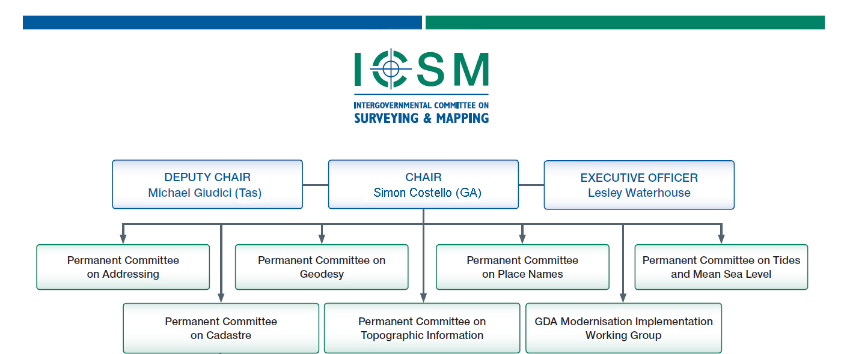
Intergovernmental Committee on Surveying and Mapping
www.sli.do #AGRS

Slide 6
Permanent Committee on Geodesy
Who: Geodesy, positioning and survey measurement leaders, advisers and advocates from Australian and New Zealand governments (states, territories and Commonwealth) and universities.
What: Provide leadership through coordination and cooperation on the Geospatial Reference Systems of Australia and New Zealand.
www.sli.do #AGRS

Slide 7
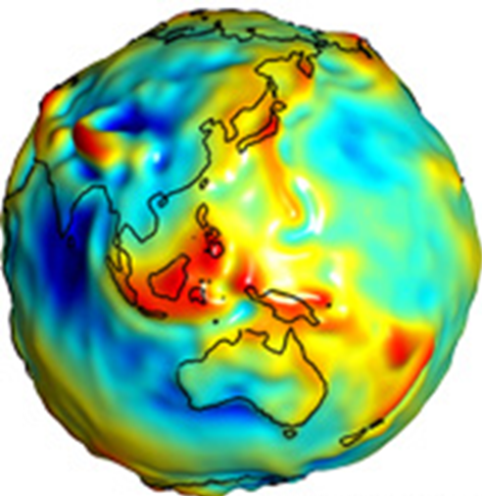
Geodesy
noun
Science of measuring the shape, orientation and gravity field of the Earth and how it changes over time.
orientation
Geospatial Reference System
noun
Collection of datums, infrastructure, models and standards required for 4D positioning.
shape
Geodesist
noun
Magical creatures who create and maintain the Geospatial Reference System.
gravity field
www.sli.do #AGRS
Notes:
Geodesy – read off screen,
GRS - explain there are geometric and physical components of a GRS

Slide 8



Geometric
Models
Geometric
Models
Physical
ATRF
GDA2020
AVWS
7 cm/yr
σ = 1-8 cm
Australian Terrestrial Reference Frame
Australian Plate Motion Model
Geocentric Datum of Australia 2020
Australian Quasigeoid Model
Australian Vertical Working Surface
AHD
Δ 1.8 m
σ = 6-13 cm
Transformation parameters / grids
AUSGeoid2020
Australian Height Datum
GDA94
People
Standards
Infrastructure
Legal framework
Software
Technical Manuals
σ = ?
Geocentric Datum of Australia 1994
AUSGeoid09
Notes:
PCG ensures Australia and New Zealand have the geospatial reference systems *including datums, reference frames, working surfaces, and standards to meet user needs.
Geometric – GPS / GNSS – WGS84 – ITRF – all geometric datums. Coordinates are based on the distance from the centre of the earth out to some position below, on or above the surface of the earth
Physical - Australian Height Datum – AUSGeoid09/AUSGeoid2020
Models – to accurately convert, transform or propagate data
Others …

Slide 9
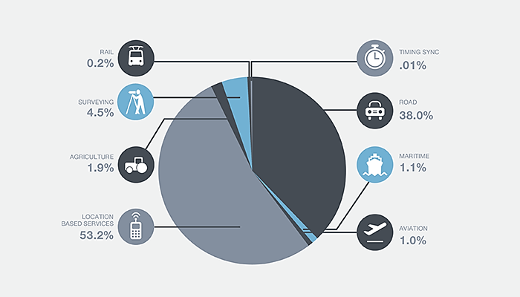
Cumulative benefits of positioning technology to the agriculture, mining and construction sectors alone by 2030 are projected to range between $32 billion and $58 billion.
The cumulative distribution of global core revenue (value of GNSS chipsets) projected by the European GNSS Agency (GSA, 2015) for the period 2013 – 2023.
www.sli.do #AGRS

Slide 10

2018-19 Australian Federal Budget
  $225m to provide centimetre accurate positioning for Australian’s anywhere, anytime.
  Includes $161 million for a Satellite-Based Augmentation System (SBAS)
    SBAS L1 (Certified)
    SBAS PPP
    SBAS DFMC (Working towards Certification)
www.sli.do #AGRS
Notes:
1. L1
The L1 service is expected to augment the Global Positioning System (GPS) constellation only over the GPS L1 frequency. This signal will be used as a safety critical system and therefore should be certified by the Australian Civil Aviation Safety Authority (CASA).
The L1 service is expected to provide sub-metre horizontal accuracies. The L1 service is required to support aviation applications that require localiser performance with vertical guidance (LPV) with a decision height of 200 feet (61 m), i.e. LPV200 approaches.
2. DFMC
The Dual-Frequency Multi-Constellation (DFMC) service is expected to incorporate two GNSS constellations over two frequencies. The service should provide sub-metre accuracy and have the potential to be SoL certified for aviation and other sectors in the future.
3. PPP
The Precise Point Positioning (PPP) service is expected to provide horizontal accuracies of 10-15cm to a range of industries, over frequencies allocated to the L-band aeronautical radio navigation-satellite. It is anticipated that the PPP service will have convergence times of approximately 30 minutes, providing L1 accuracies before converging to the 10-15cm horizontal accuracy. Geoscience Australia states it prefers an open access PPP service that should be able to be incorporated onto mass market GNSS devices.

Slide 11
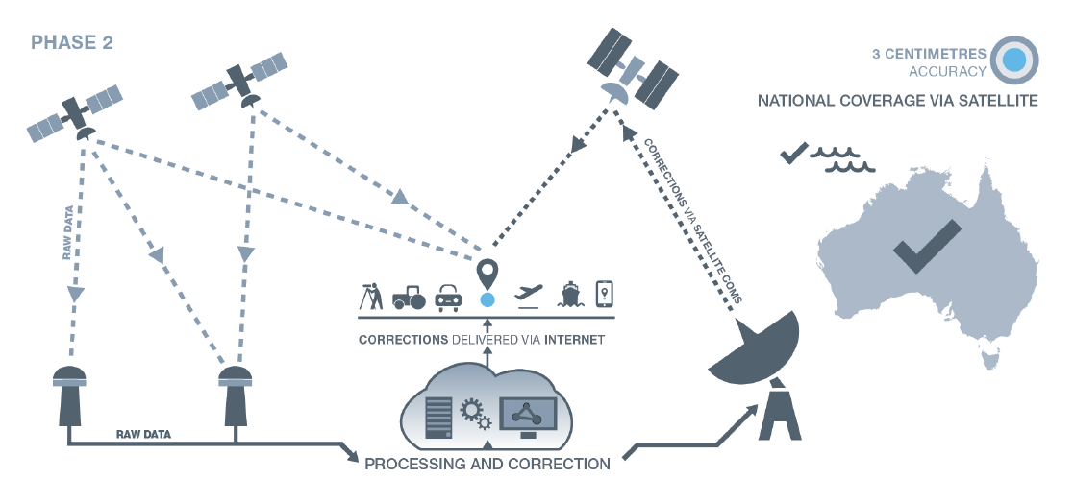
Accuracy
3-10 cm
www.sli.do #AGRS

Slide 12
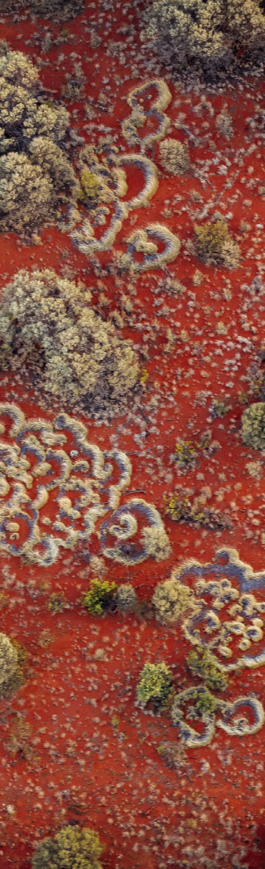


Positioning Australia’s Mission

Slide 13
SBAS Test-Bed Reports
https://frontiersi.com.au/project/satellite-based-augmentation-system-test-bed/

Slide 14
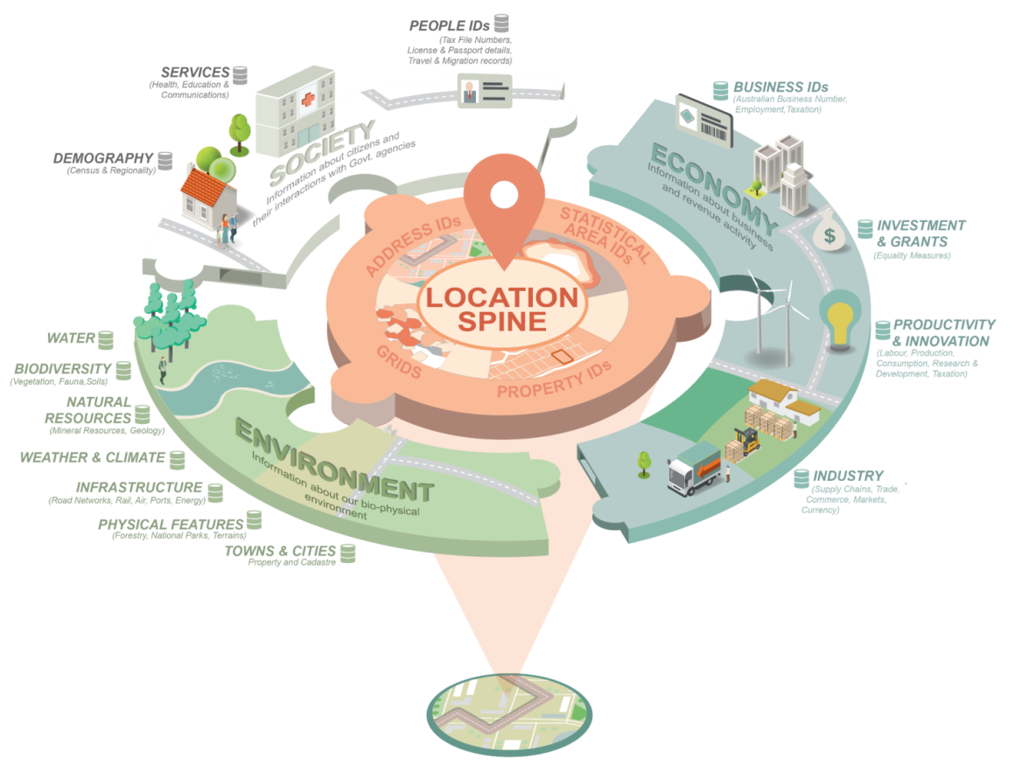

Source: Australian Government
www.sli.do #AGRS
Notes:
The success paradox – Mark Weiser, Chief Scientist of Xerox PARC (1991)
“The most profound technologies are those that disappear. They weave themselves into the fabric of everything life until they are distinguishable from it”

Slide 15





Spatial Awareness
BIM
// Positioning Program //
Will provide:
“Instant, reliable and accurate access to positioning and timing information anytime and anywhere across Australia.”
Australian government has committed $225M over four years to implement 5-10 cm accurate positioning.
// 2026 Spatial Agenda //
Foresees:
“New and innovative applications in intelligent transportation systems (ITS), precision agriculture, construction, logistics, machine automation, mining and location-based services (LBS).”
Need:
“Nationwide location innovation ecosystems that allow entrepreneurs, start-ups and researchers to access real-world data for commercialisation.”
// Smart cities, IoT, BIM //
Foresees:
Smart Cities will be connected by the Internet of Things (IoT) and Building Information Modelling (BIM)
// Cadastre 2034 //
Foresees + Need:
“The creation of a 4D cadastre underpinned by a coordinate system with a dynamic datum.”
Need:
“Improve spatial accuracy; Improve vertical datum; Link geodetic and cadastral frameworks; Develop 3D and 4D standards and models.”
www.sli.do #AGRS
Notes:
As you can see from the spatial agendas and strategic plans on the screen, the Australian spatial sector has determined a suite of high priority initiatives will make an essential contribution to the transformation and growth of the Australian economy and accelerate the realisation of benefits to the wider community over the next decade.
These include …

Slide 16
Australian Geospatial Reference System
BIM
www.sli.do #AGRS
Notes:
The Australian Geospatial Reference System GRS is the collection of datums, infrastructure, models and standards that underpin and enable these industries to thrive, and meet the objectives described in their strategic plans
It is the role of PCG to develop and provide the GRS

Slide 17
www.sli.do
#AGRS
www.sli.do #AGRS

Slide 18
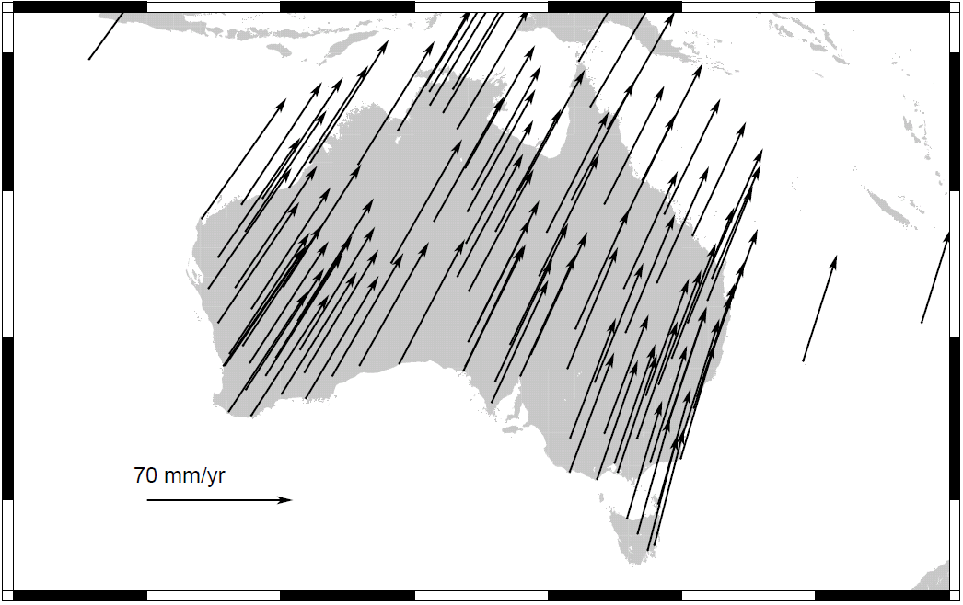
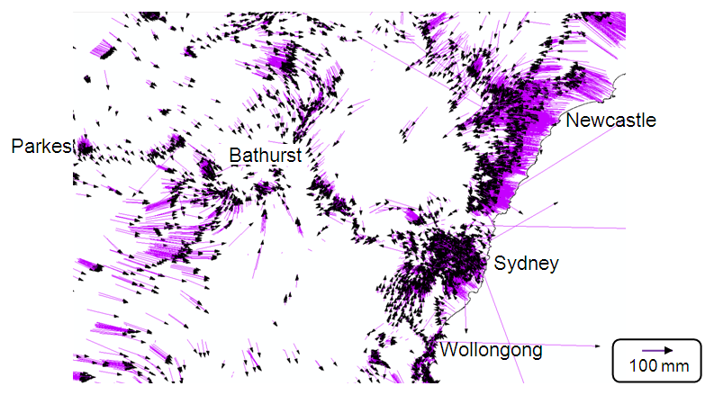
Data can only be as accurate as your datum
Geocentric Datum of Australia 1994 bias and distortion
Source: Joel Haasdyk and Tony Watson, LPI NSW, APAS Conference 2013
~1.8 m between 1994 and 2020
Up to 0.5 m
www.sli.do #AGRS

Slide 19
Why is a datum useful?
Accurate data help you make good decisions
Any error in the datum causes error in your decision making process
Your data can only be as accurate your the datum
and accurate datums
www.sli.do #AGRS

Slide 20

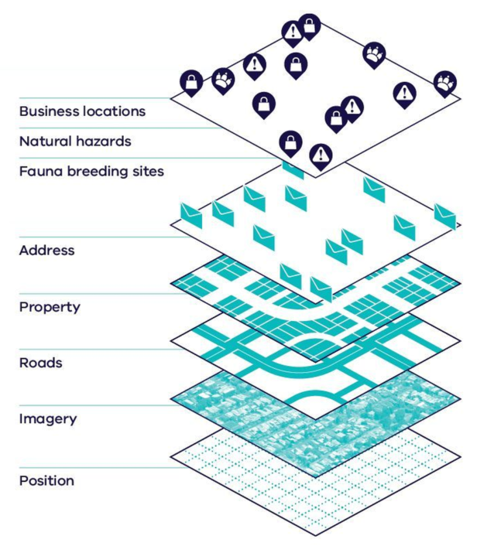
Upgrading the Australian Geospatial Reference System
“Two-frame system”
GDA2020
ATRF
Positions from GNSS satellites do match data on GDA2020
Offset from GNSS: 0 m on 1/1/2020
Spatial data is aligned at 10 cm level for improved decision making
Available from 1/1/2020
Time Dependent Reference Frame
Positions updated with time to reflect true location on Australian Plate
Useful for Intelligent Transport Services and Location Based Services
Geocentric Datum of Australia 2020
Australian Terrestrial Reference Frame
GDA94
Positions from GNSS satellites do not match data on GDA94
Offset from GNSS: ~1.8 m (~7 cm / plate tectonic motion
Spatial data can’t be aligned for good decision making
We aren’t capitalising on the benefits of precise positioning
Geocentric Datum of Australia 1994
www.sli.do #AGRS

Slide 21
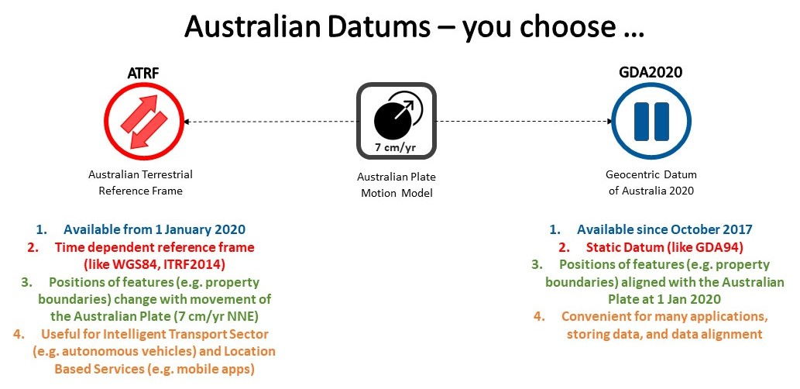
GDA2020 and ATRF
www.sli.do #AGRS

Slide 22
www.sli.do
#AGRS
www.sli.do #AGRS

Slide 23
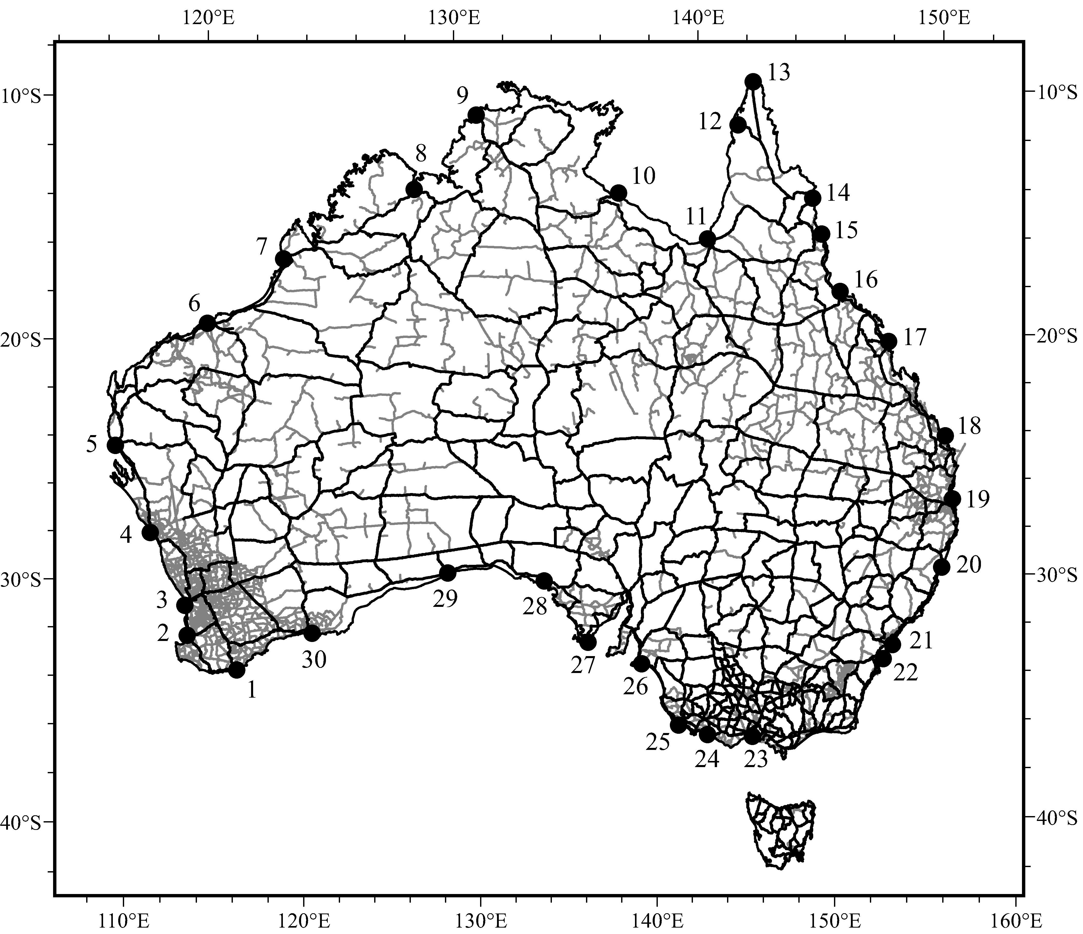
Australian Height Datum
AHD
Australian Height Datum
Mean sea level (MSL) observed at 30 tide gauges from 1966-1968
MSL = 0.000 m AHD
Over 200,000 km of levelling to transfer heights
AHD ≠ MSL
AHD ≠ geoid
www.sli.do #AGRS
Notes:
AHD isn’t MSL because it is only based on 3 years of tidal records.
AHD also isn’t geoid …

Slide 24
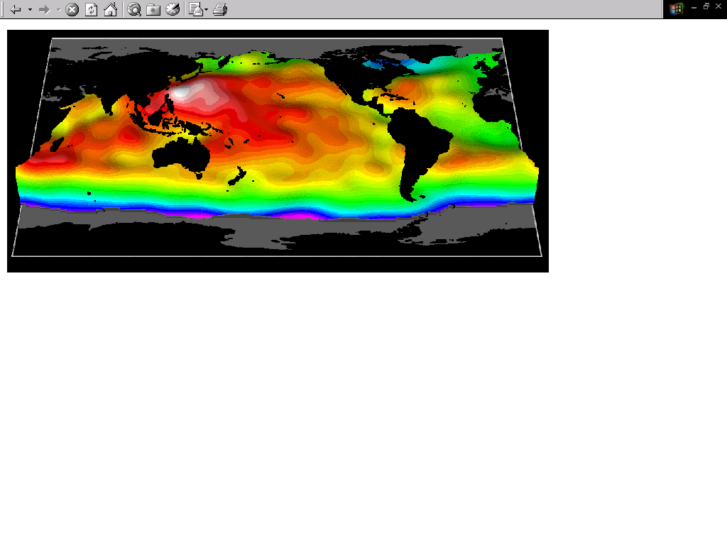
The cause of the geoid – AHD offset
The mass of water in southern and northern Australia is almost the same, however, the density is not.
The warmer / less dense water off the coast of northern Australia (red) is approximately one metre higher than the cooler/denser water off the coast of southern Australia (yellow).
Therefore, the AHD is about 0.5 m above the geoid in northern Australia and roughly 0.5 m below the geoid in southern Australia.
Source: NASA JPL
www.sli.do #AGRS

Slide 25
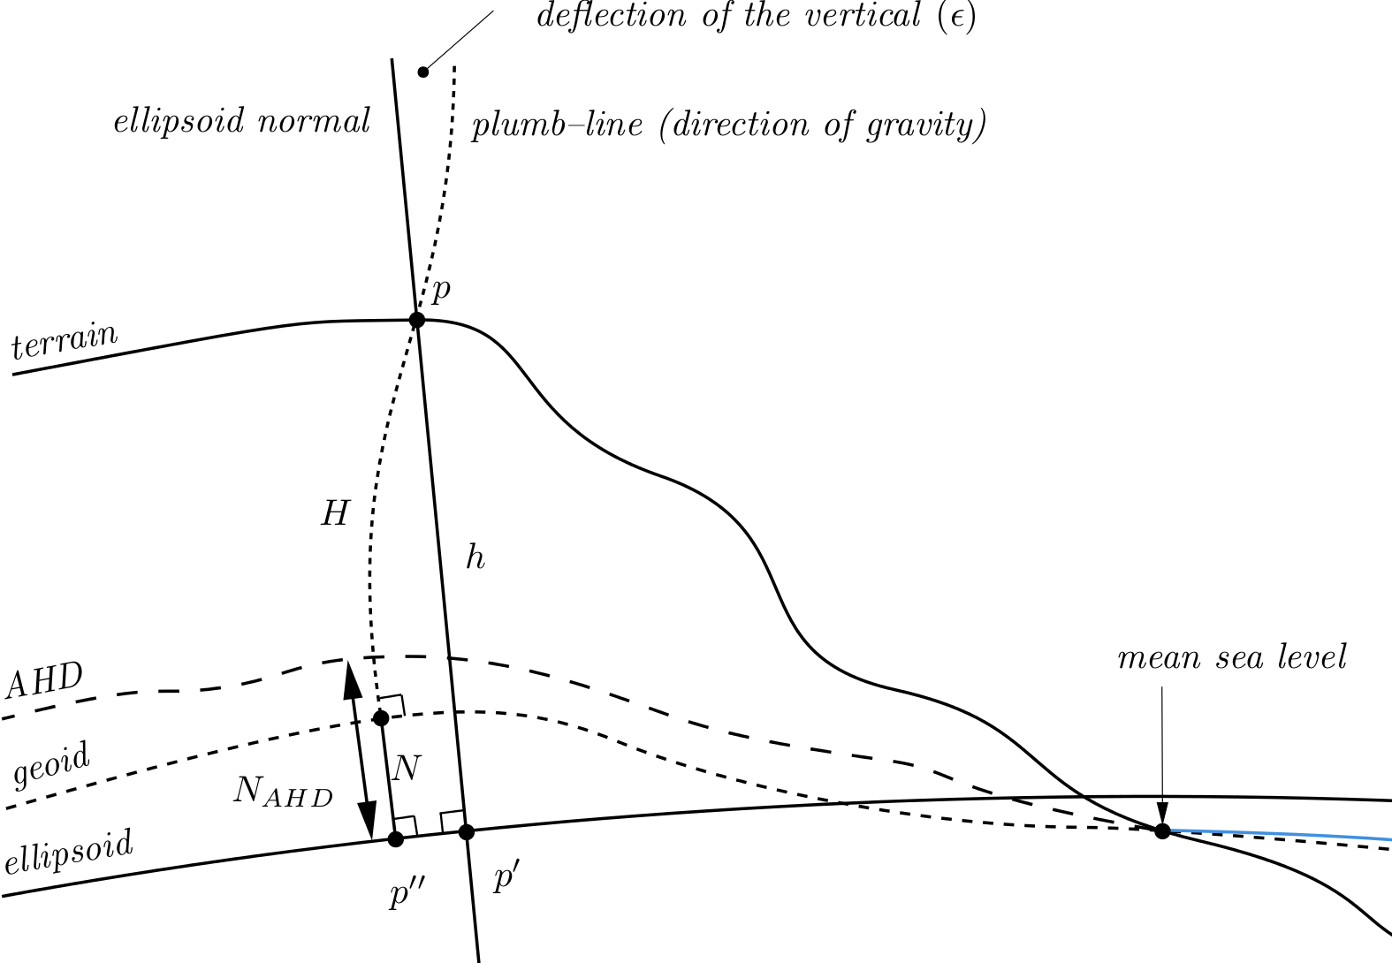
GNSS height
Geometric (-0.5 to 0.5 m)
Gravimetric (-30 to +80 m)
AUSGeoid2020
www.sli.do #AGRS
Notes:
So the offset between AHD and the geoid throughout Australian varies between -0.5 and +0.5 m across Australia. The AHD is roughly 0.5m below the geoid in southern Aus and AHD is about 0.5 m above the geoid in northern AUS.

Slide 26
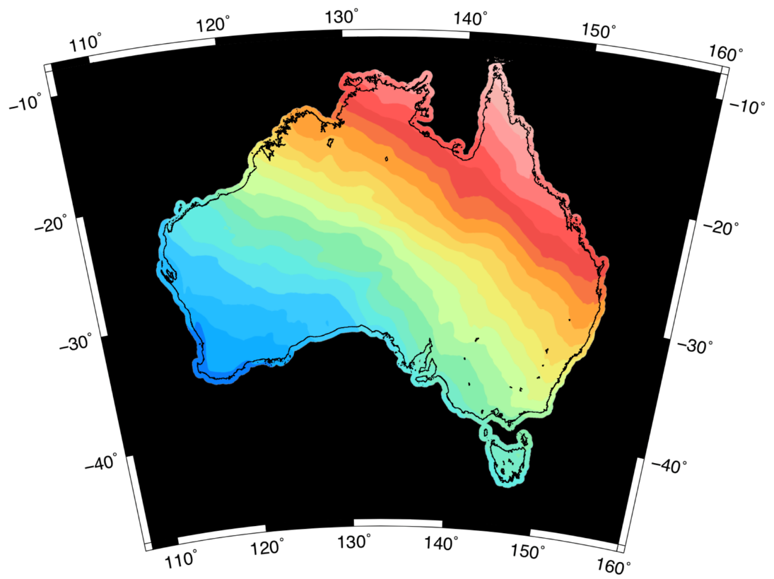
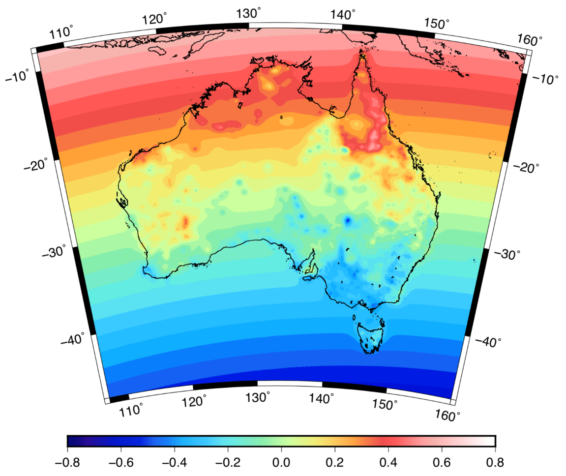

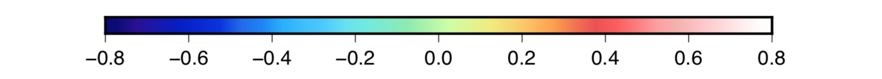
AUSGeoid2020 model
Gravimetric component
Geometric component: Bias and Error
m
m
@nich0lasbr0wn

Slide 27
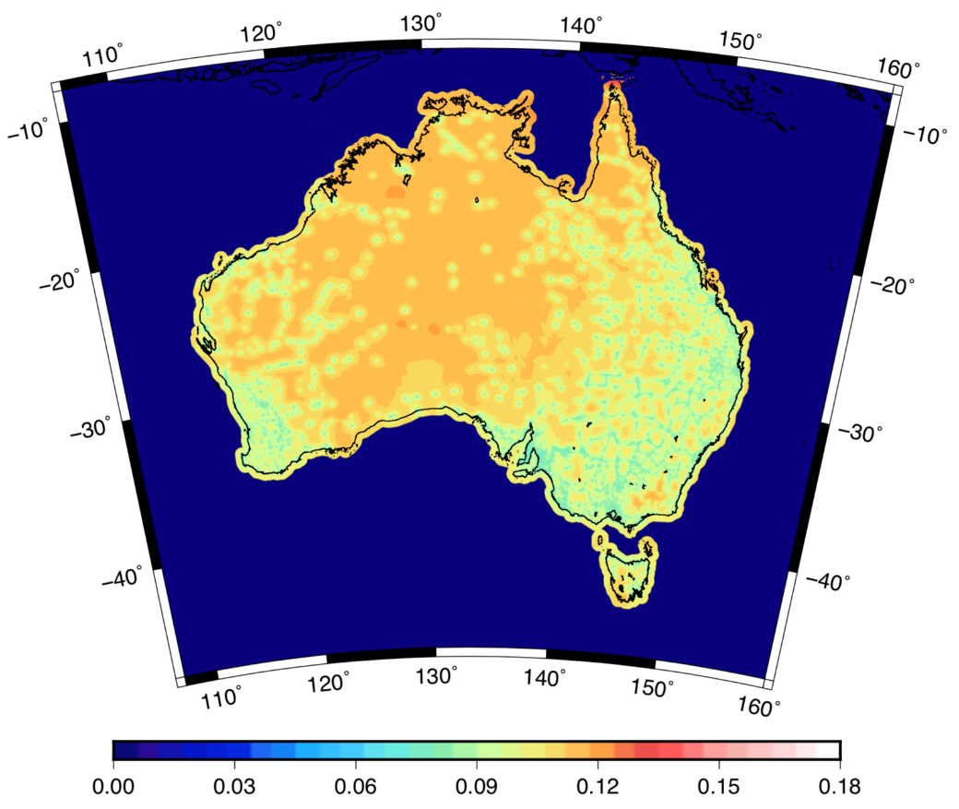
AUSGeoid2020: combined gravimetric-geometric model
AUSGeoid2020 allows for physical height transfer from GNSS to be efficient and accurate (for some applications).
More accurate in providing difference in orthometric height than levelling over distances greater than 3 km (12√k)
A rigorous combination of uncertainty from gravimetric and geometric components shows AUSGeoid2020 has 8-13 cm uncertainty (1 sigma)
Some users may need accuracy better than this
Users are asking “Is the error in the data or the datum?” (e.g. LiDAR surveys)
AUSGeoid2020 accuracy
(8 – 13 cm)
m
www.sli.do #AGRS

Slide 28

Australian Vertical Working Surface – gravimetric component
AVWS
Australian Vertical Working Surface
Updated version of the gravimetric component of AUSGeoid2020
Bias and distortion of AHD has been removed
Smoother surface for LiDAR, remote sensing, environmental modelling, major projects (e.g. road construction)
Works seamlessly on and offshore
m
www.sli.do #AGRS

Slide 29
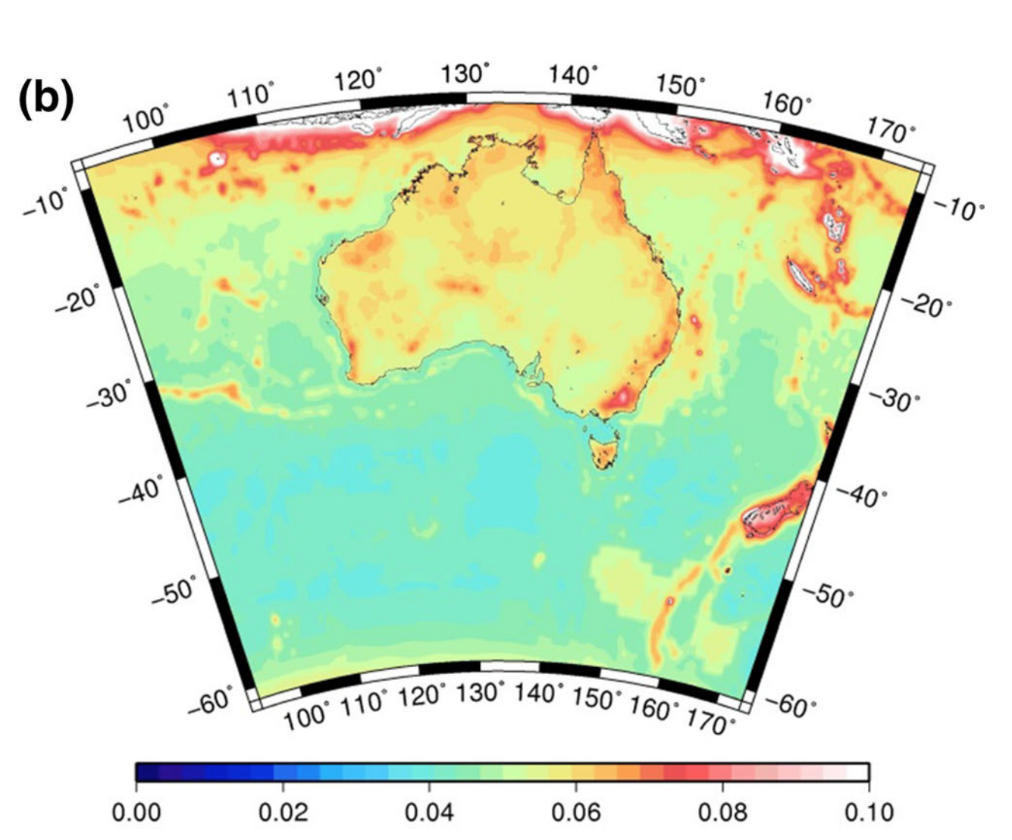

AUSGeoid2020 accuracy vs AVWS accuracy
AUSGeoid2020 accuracy
(8 – 13 cm)
AVWS accuracy
(1 – 8 cm)
m
m
Brown et al. (2018), Journal of Geodesy
Featherstone et al. (2017), Journal of Geodesy
www.sli.do #AGRS

Slide 30
www.sli.do
#AGRS
www.sli.do #AGRS

Slide 31
Need for improved geodesy standards
Current formats and standards for delivering geodetic data will not adequately serve the needs of new (non-geodetic) users, who will emerge on account of the rapid growth in precise positioning services.
Broad, multi-domain, standards are important for combining geodetic data with data from other domains.
Internationally, several groups (e.g. Inspire, DCAT, ESIP, CODATA) are working on defining standards for geospatial and geophysical metadata and enhancing interoperability.
However, there is no international strategy to ensure geodetic data is Findable, Accessible, Interoperable and Reusable (FAIR).
www.sli.do #AGRS

Slide 32
UN GGIM SCoG
(intergovernmental)
IAG GGOS
FIG
Comm 5
ISO TC 211
GEO
(intergovernmental)
…
Efficiency?
Experts from Standards?
Experts in software development?
Many groups active in this space
Standards (ISO/OCG/GeodesyML)
Some open geodetic standards exist
Unknown gaps
Industry / Research Community / IAG Services / Software Developers
Mostly proprietary?
Unknown gaps
End User (mobile phone holder / autonomous vehicle)
www.sli.do #AGRS

Slide 33
Extending Geography Markup Language (GML)
GML provides a rich set of primitive objects like (geometry, coordinate reference system, time etc.)
But not detailed / specific standards
The geodetic standard needs objects like antenna, receiver, cable, adjustments etc.
GML Application Schemas extend GML to meet the needs of a specific community of interest (e.g. SensorML, GeoSciML, GeodesyML (proposed))
www.sli.do #AGRS

Slide 34

www.sli.do #AGRS

Slide 35
GeodesyML
GeodesyML (www.geodesyml.org) goes some way to dealing with the issues of making GNSS data and the associated metadata available to the new and emerging user base in a standardised, discoverable and interoperable way.
However, GeodesyML doesn’t deal with all metadata requirements for precise positioning (e.g. compatibility with Intelligent Transport Systems and mobile phone standards).
Furthermore, GeodesyML requires further development from people with experience working on OGC and ISO standards to ensure it can interface with complementary standards (e.g. SensorML, TimeseriesML, etc.)
www.sli.do #AGRS

Slide 36
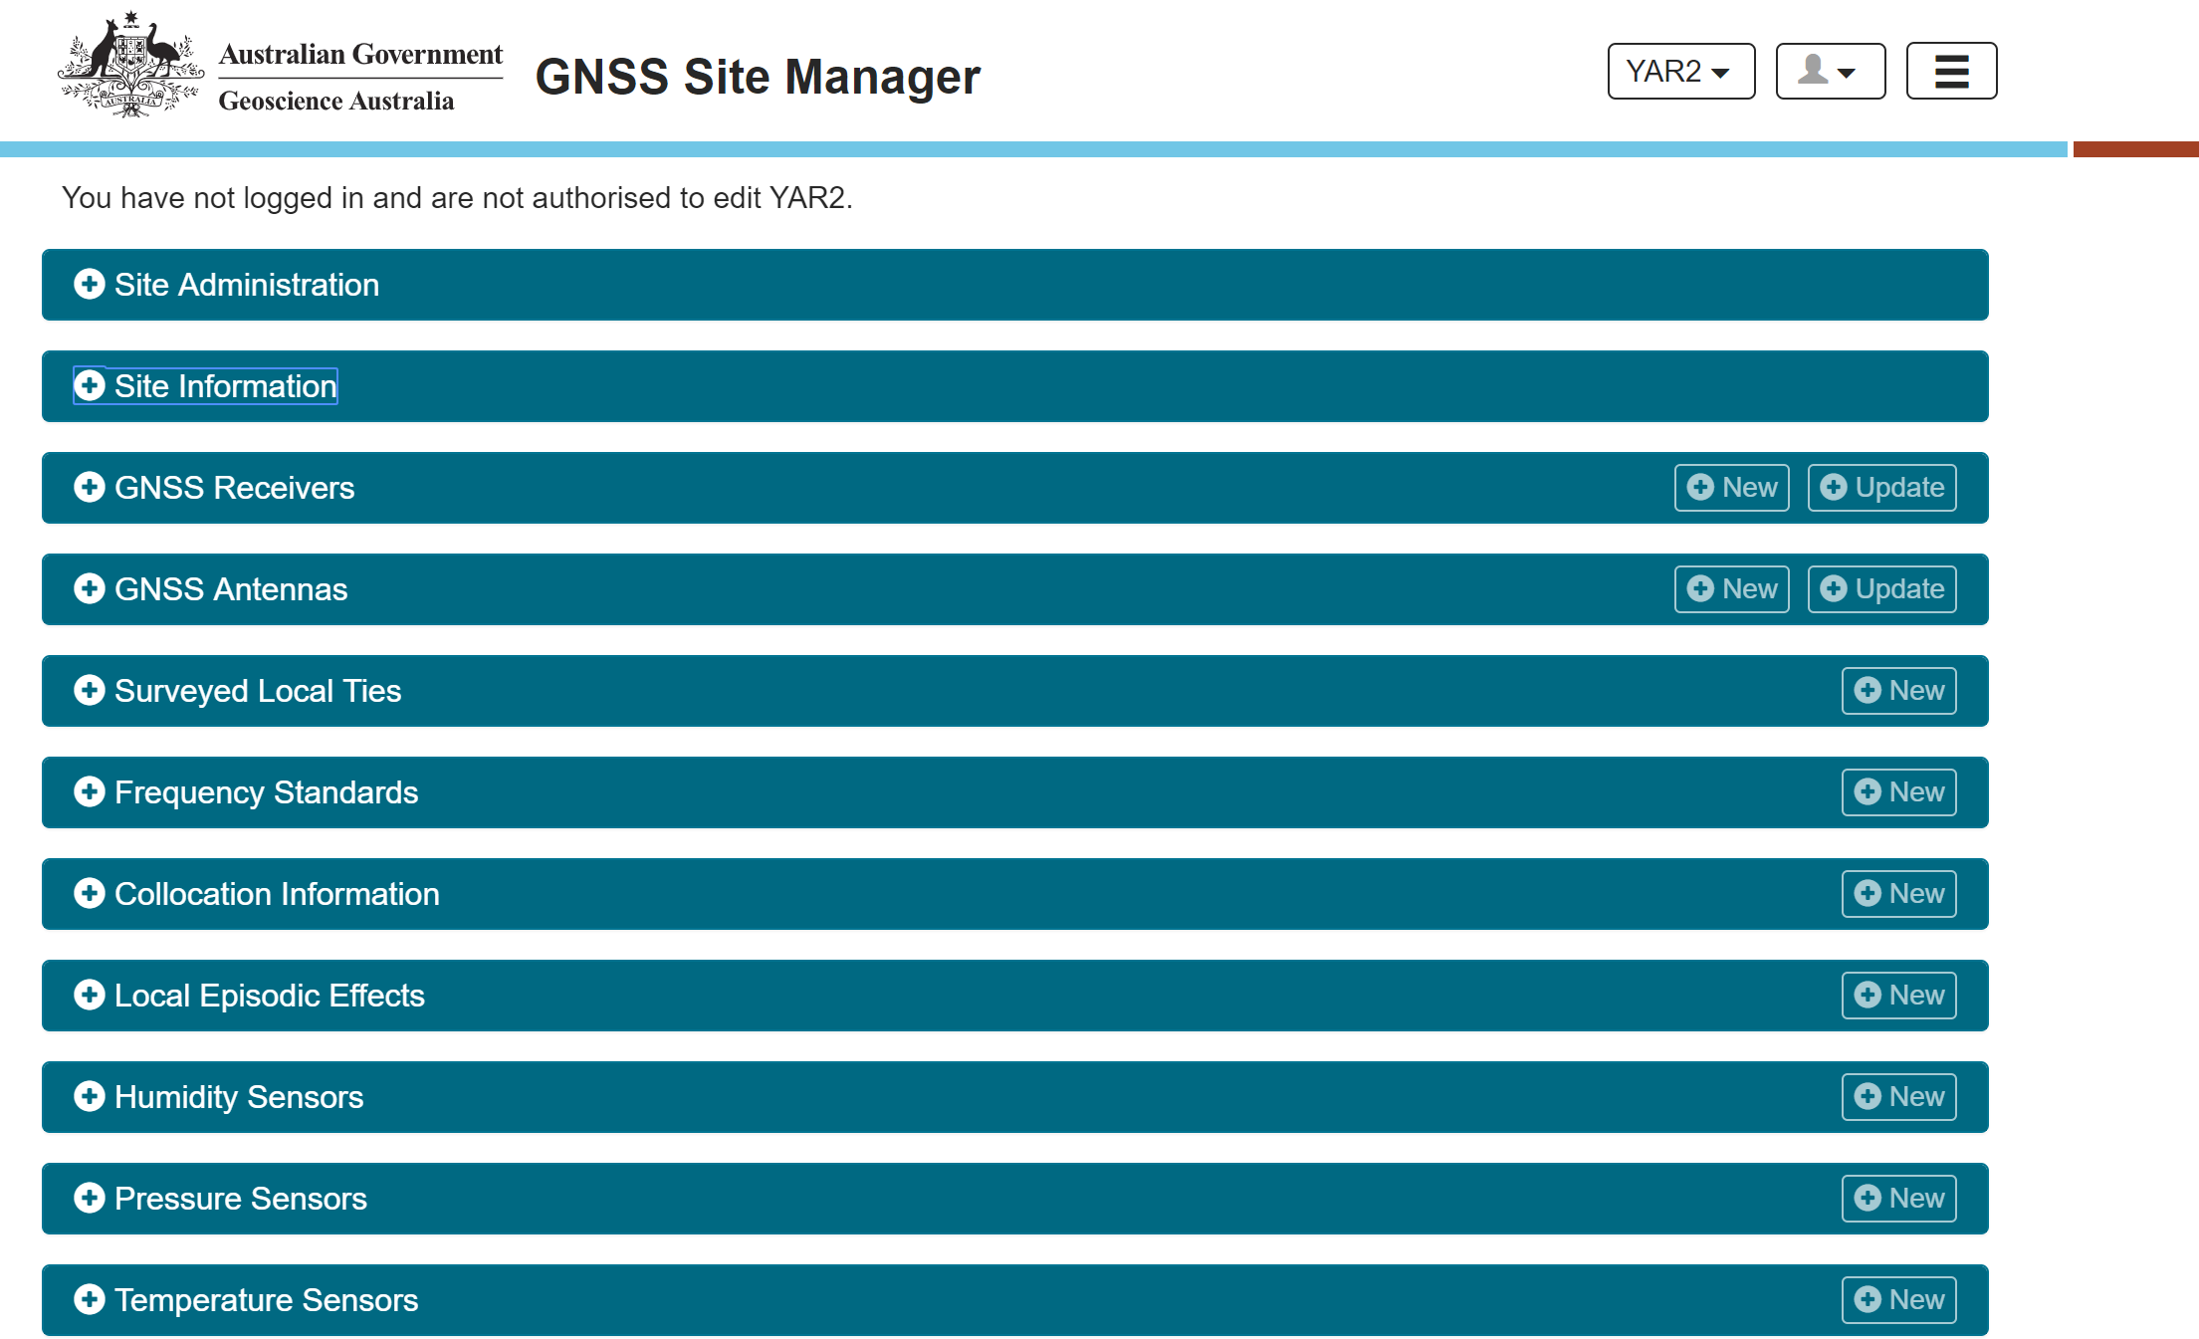

Slide 37
ATRF
GDA2020
AVWS
7 cm/yr
σ = 1-8 cm
Australian Terrestrial Reference Frame
Australian Plate Motion Model
Geocentric Datum of Australia 2020
Australian Quasigeoid Model
Australian Vertical Working Surface
Webinar 3: ATRF
AHD
Δ 1.8 m
σ = 6-13 cm
Webinar 2: GDA2020
Transformation parameters / grids
AUSGeoid2020
Australian Height Datum
GDA94
Webinar 4: Height
σ = ?
Geocentric Datum of Australia 1994
AUSGeoid09
@nich0lasbr0wn
Notes:
PCG ensures Australia and New Zealand have the geospatial reference systems *including datums, reference frames, working surfaces, and standards to meet user needs.
It’s complex – yes – but as we try to measure things more accurately, we need to ensure we have the grs to enable those applications.

Slide 38
Summary
Positioning Australia – accurate and reliable positioning for everyone (3-10 cm) anywhere, anytime in Australia.
The Australian Geospatial Reference System needs to be upgraded to support demanding user requirements.
We are limited in our ability to provide Findable, Accessible, Interoperable and Reusable (FAIR) data (for now).
We need to upgrade the Australian Geospatial Reference System so people can get maximum benefit from precise positioning.
PCG and ICSM are able to answer questions and help
Join the conversation …
www.sli.do #AGRS
Notes:
We are no longer an esoteric science, we provide the foundation of decision making

Slide 39
Connect with us
ICSM [http://www.icsm.gov.au]
ICSM-PCG Slack [http://cutt.ly/join-pcg-slack]
GDA Modernisation Implementation Working Group
GDA2020 Forum [https://www.icsm.gov.au/datum/gda2020-forum]
GitHub – Geoscience Australia Geodesy Python software [https://github.com/GeoscienceAustralia/GeodePy]
GitHub – ICSM Australian Geospatial Reference System tools and software [https://github.com/icsm-au]
GeodesyML [http://www.geodesyml.org/]
Twitter - Nicholas Brown [@nich0lasbr0wn] - Chair of PCG
Email geodesy@ga.gov.au
www.sli.do #AGRS

Slide 40
www.sli.do
#AGRS
www.sli.do #AGRS

