Slide 1
Standards for data quality @ISO/TC211
Dr Ivana Ivánová

Slide 2
Brief history of Spatial Data Quality
1994 – foundation of ISO/TC211 & OGC
1972 – launch of Landsat 1
2004 – definition of GSDI
1960s – birth of GIS
1985 – operational GPS
1940
1975-1980
1991
2003 – 2013 - …
NMAS standard:
positional accuracy of
0.5-0.8mm for 90% objects
topology in
cartographic structures
appears as an interesting
research problem
introduction of the
misclassification
matrix
ISO standards for
spatial data quality

Slide 3
ISO Standards for spatial data quality
ISO 19113:2002 – Geographic information – Quality principles
ISO 19114:2003 – Geographic information – Quality evaluation procedures
ISO 19115:2003 – Geographic information – Metadata
ISO 19115-2:2009 Geographic information – Metadata – Part 2: Extensions for imagery and gridded data
ISO 19131:2007 – Geographic information – Data product specification
ISO/TS 19138:2006 – Geographic information – Data quality measures
ISO/TS 19158:2012 – Geographic information – Quality assurance of data supply

Slide 4
ISO Standards for spatial data quality
ISO 19113:2002 – Geographic information – Quality principles
ISO 19114:2003 – Geographic information – Quality evaluation procedures
ISO 19115:2003 – Geographic information – Metadata
ISO 19115-1:2014 – Geographic information – Metadata – Part 1: Fundamentals
ISO 19115-2:2009 Geographic information – Metadata – Part 2: Extensions for imagery and gridded data
ISO 19131:2007 – Geographic information – Data product specification
ISO/TS 19138:2006 – Geographic information – Data quality measures
ISO/TS 19158:2012 – Geographic information – Quality assurance of data supply
ISO 19157:2013 – Geographic information – Data quality
ISO 19157-2:2016 – Geographic information – Data quality – Part 2: XML Schema implementation

Slide 5
ISO 19157 is currently under revision
Rationale:
  2018-2019 Systematic Review on ISO 19157:2013 – result: 19 confirm, 3 revise, 14 abstain
  Main reasons for proposed revision:
    need to harmonize the terminology,
    align with current best practice, incl. enabling resources for the Web.
ISO/NP 19157-1 Geographic information –
Data quality – Part 1: General requirements

Slide 6
ISO 19157-1 – the project
Project team:
  Leaders: Standards Australia (Dr Ivana Ivánová) and Swedish Institute for Standardization (Mr. Torsten Svärd)
  Team: around 30 Spatial Data Quality experts, fans or member body representatives
  Timeline:
    Start – July 2019
    CD– Dec 2020
    DIS – Dec 2021,
    IS – Dec 2022.
We are here now

Slide 7
ISO 19157-1 – the revision process
WD/CD based on comments and discussions:
  During ISO/TC211 Systematic Review (DK, SE, NO) and @prompt received btw Oct 2019 and Mar 2020 (ES, CHL), and
  During ISO 19157-1 project meetings @ 49th,50th and 51st plenary
  coms with experts in ISO/TC211(HMMG, PMG and the Secretariat);
  …and elsewhere:
    OGC DQ DWG;
    Eurogeographics’ QKEN;
    Nordic Data Quality Group;
    Ribose;
    AU/NZ Data Quality Interest Group.

Slide 8
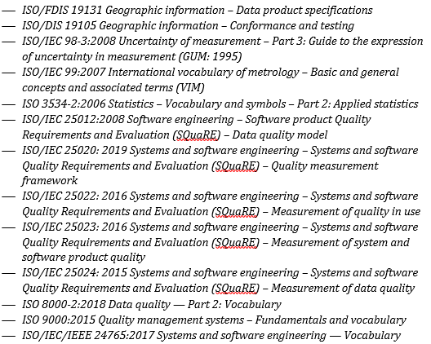
ISO/CD 19157-1 – Main changes:
Terms and definitions updated and harmonised with other relevant standards;

Slide 9
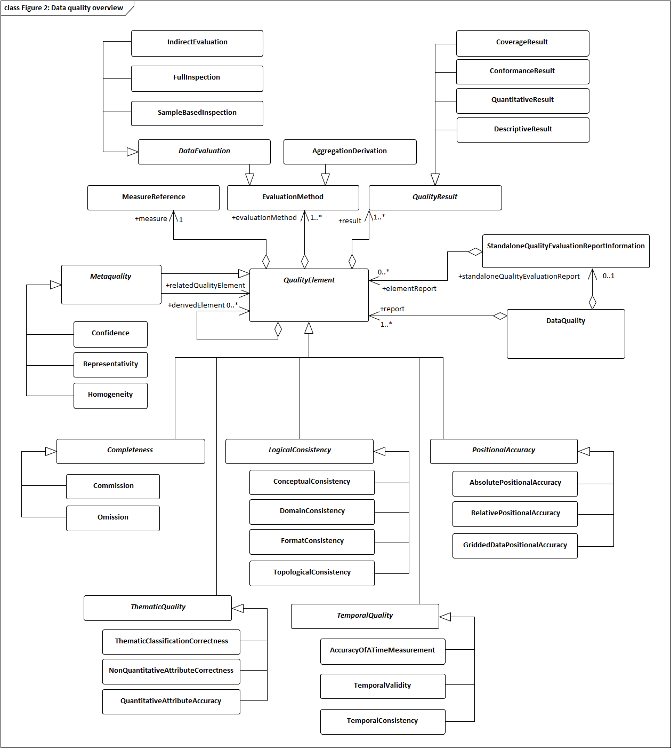
ISO/CD 19157-1 – Main changes:
Terms and definitions updated and harmonised with other relevant standards;
Quality model (slightly) updated;

Slide 10
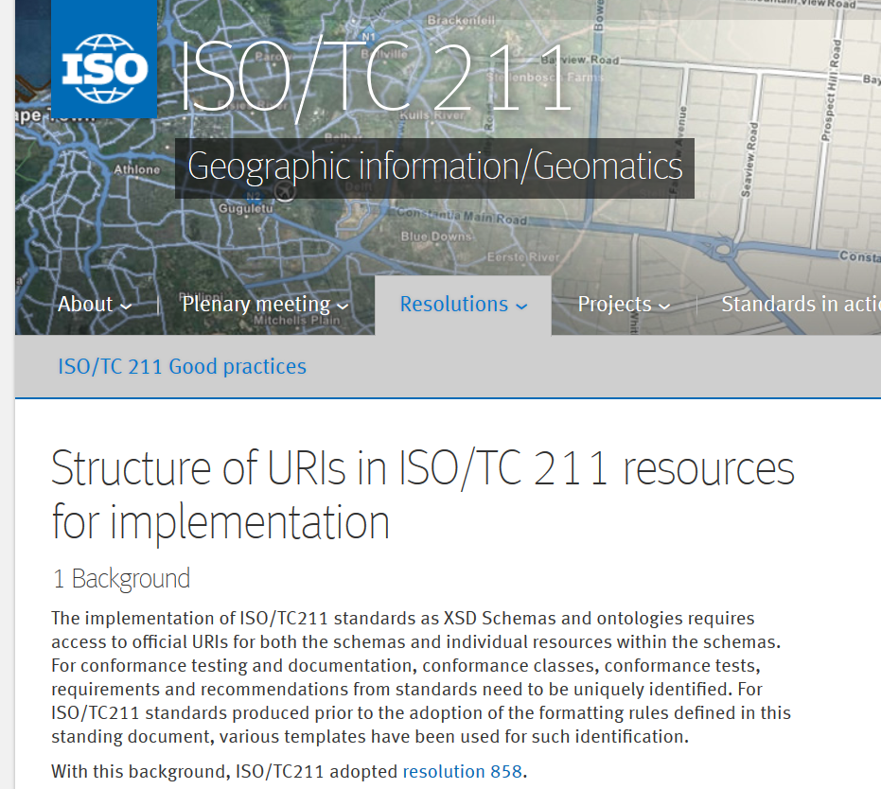
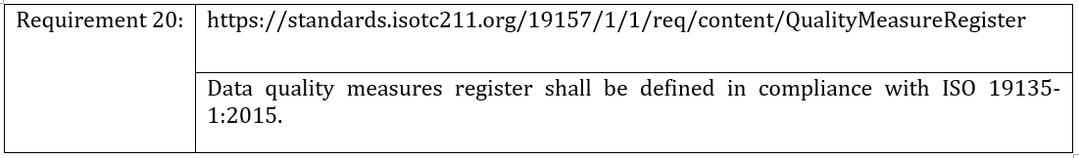
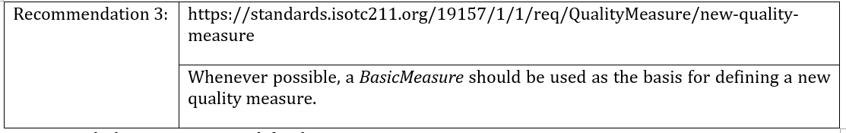
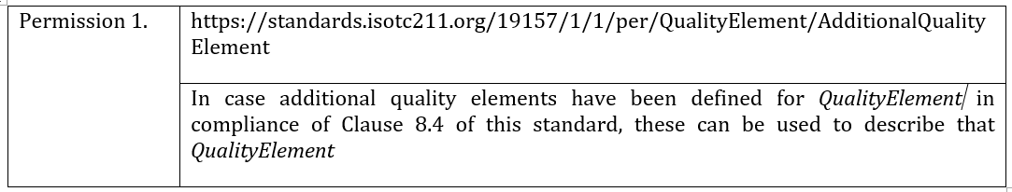
ISO/CD 19157-1 – Main changes:
Terms and definitions updated and harmonised with other relevant standards;
Quality model (slightly) updated;
Set of Requirements, Recommendations and Permissions introduced;

Slide 11
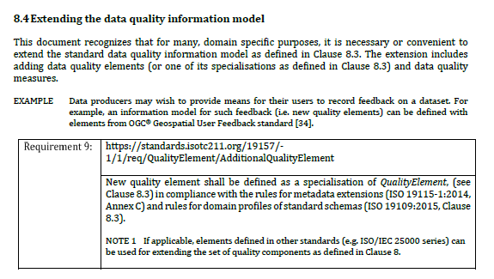
ISO/CD 19157-1 – Main changes:
Terms and definitions updated and harmonised with other relevant standards;
Quality model (slightly) updated;
Set of Requirements, Recommendations and Permissions introduced;
Quality model is now (again) extensible!

Slide 12
ISO/CD 19157-1 – Main changes:
Terms and definitions updated and harmonised with other relevant standards;
Quality model (slightly) updated;
Set of Requirements, Recommendations and Permissions introduced;
Quality model is now (again) extensible!
Data quality measures have a chance to be released from their PDF prison!!!

Slide 13

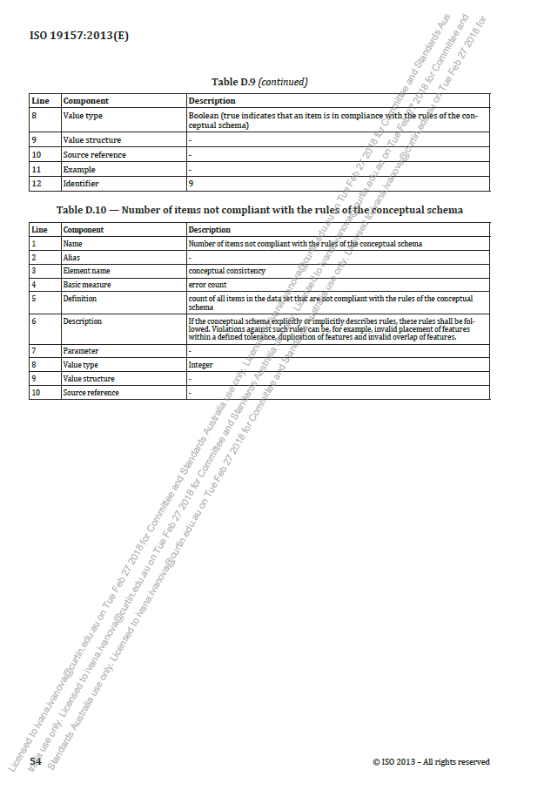
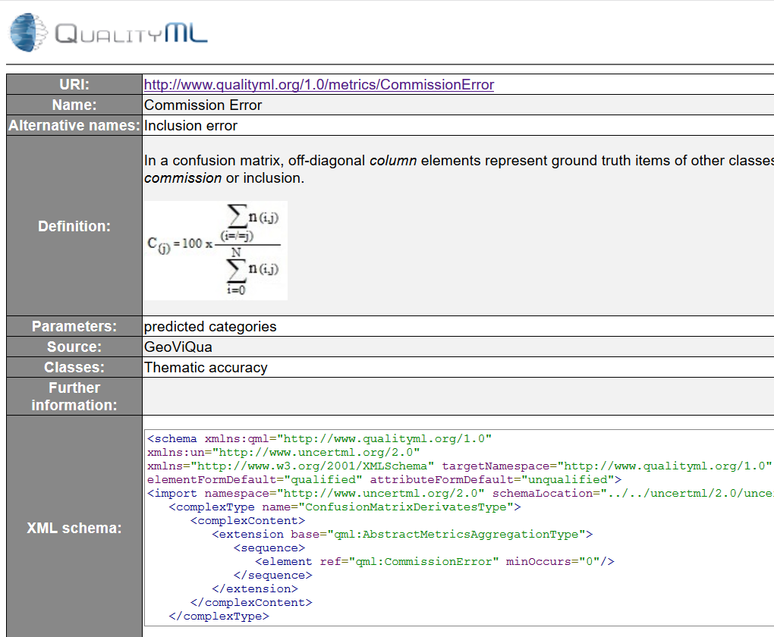
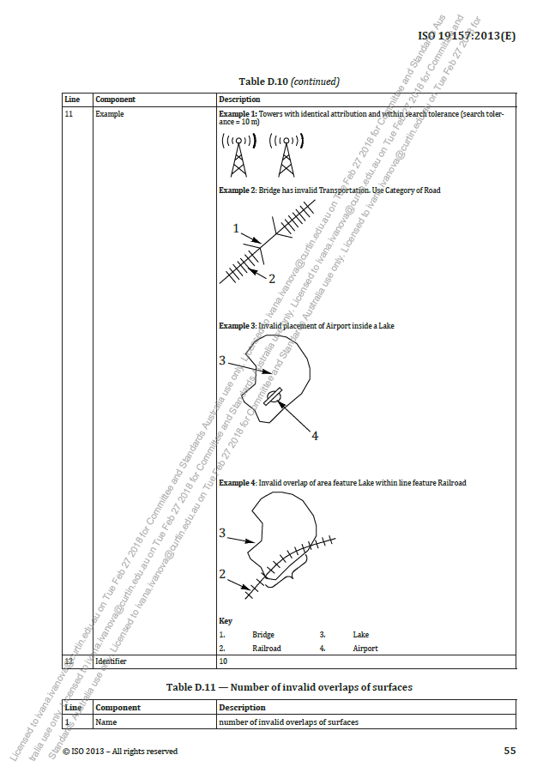

What’s the problem with DQ measures?
Data quality measures are not accessible
for automatic consumptions;
http://qualityml.org
a custom register has data quality metrics and quality measurements

Slide 14
What’s the problem with DQ measures?
Data quality measures are not accessible
for automatic consumptions;
Extensibility is complicated – list of measures is revised only during the standard revision;
… not in par with current best practice (at W3C, OGC and also ISO/IEC) of interoperable spatial resources;

Slide 15
Proposed solution:
Define data quality measure concept in ISO 19157-1,
Done – Clause 9 in ISO/CD 19157-1
And:
Set-up standard-compliant data quality measures register.

Slide 16
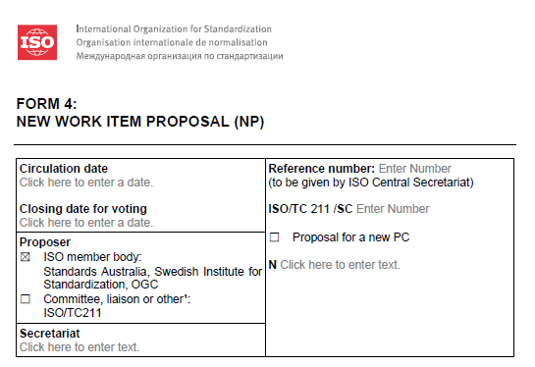
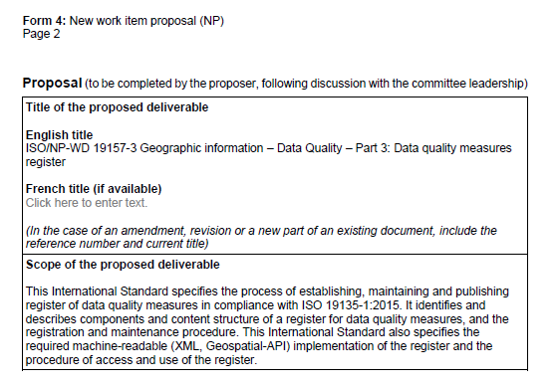
ISO/NWIP 19157-3
This has been a long battle, but ISO/TC211 Secretariat finally gave in:
Expected (hopefully) in Dec 2022

Slide 17
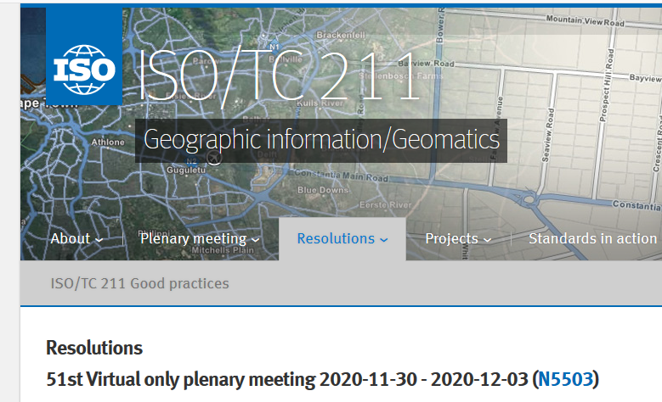
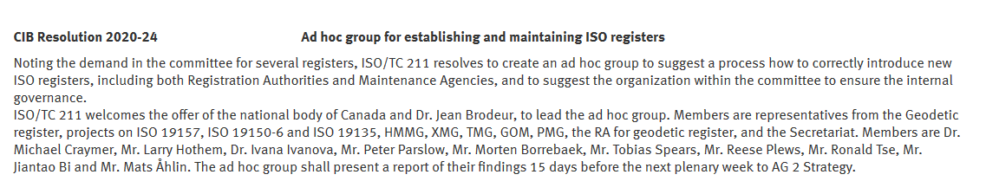
ISO/NWIP 19157-3
But that’s not all:
ISO 19157-3 is going to be “the first ISO/TC211 register by the ISO/TC211 and ISO/CS books” (Mats Åhlin, ISO/TC211 Manager – ISO/TC211 Secretariat, WG9 Convenor and Ivana zoom meeting on 19 Feb 2021 at 4am AWST)

Slide 18
THANK YOU!
ivana.ivanova@curtin.edu.au

