Slide 1
Who Are They?
What Do They Do?
IALA & S100/200

Slide 2
IALA Update from the Joint IHO-IALA Workshop S-100/S-200 Product Specification Development
WG1: Initialising and Productising of S-100 Series Data
WG2: S-201, 124 and 125 Development
WG3: S-98 Interoperability and Marine AtoN Portrayal
Conclusions

Slide 3
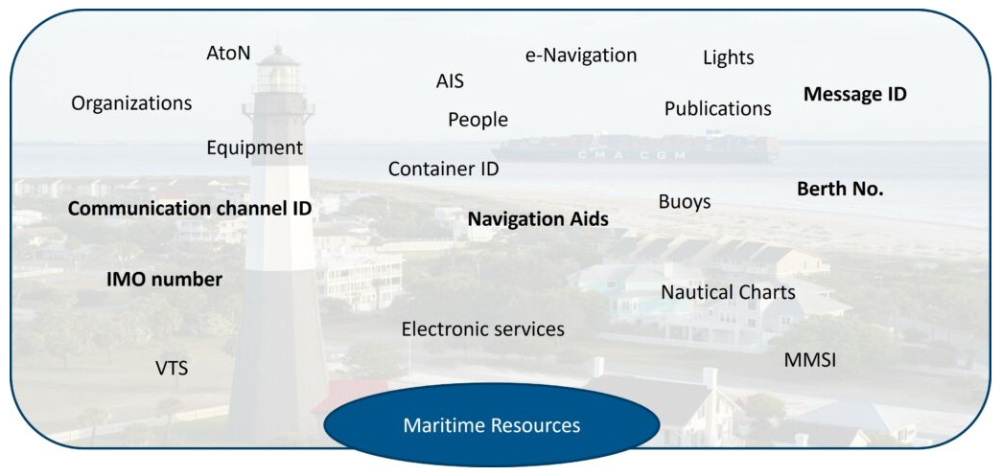
MRN (Maritime Resource Name) – The Way Forward

Slide 4
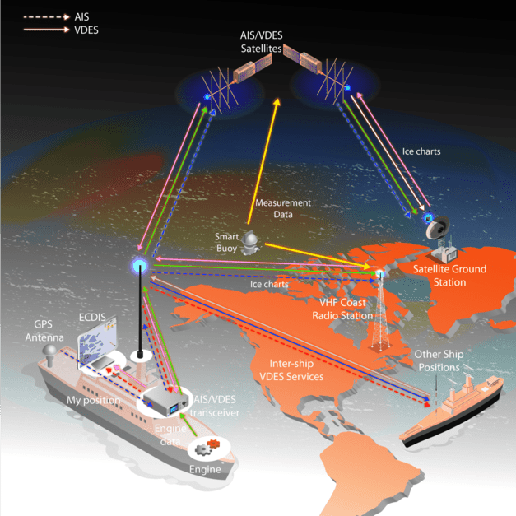
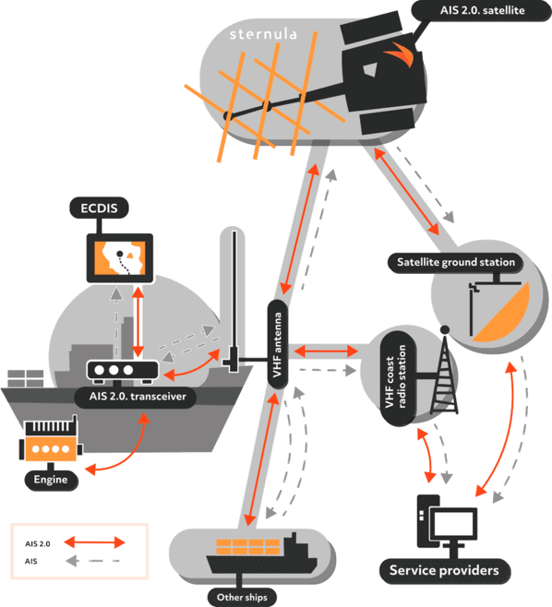
What is VDES (VHF Data Exchange System)?

Slide 5
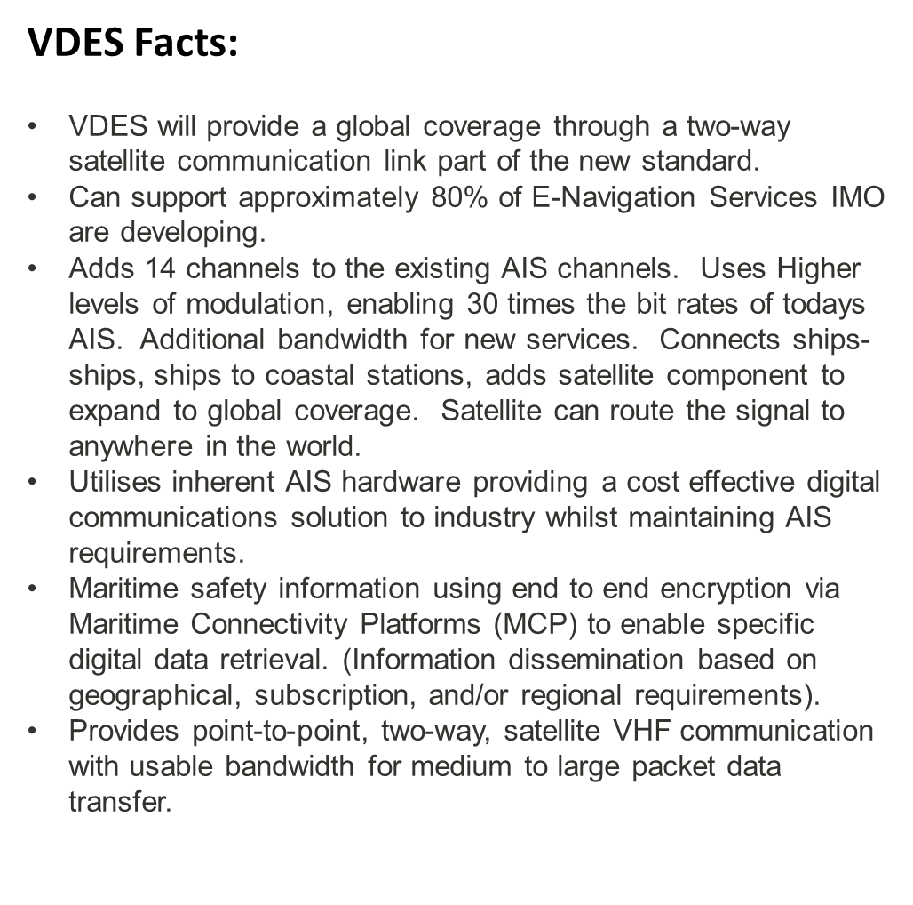
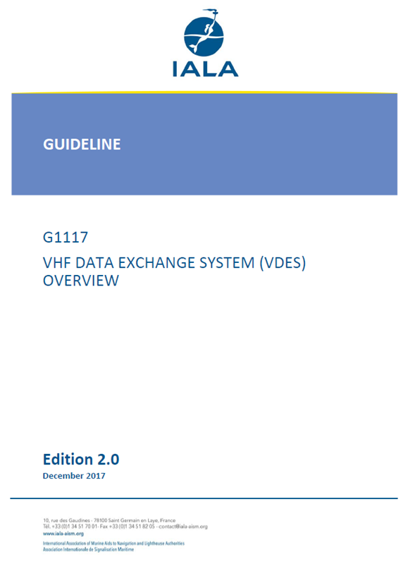

Slide 6
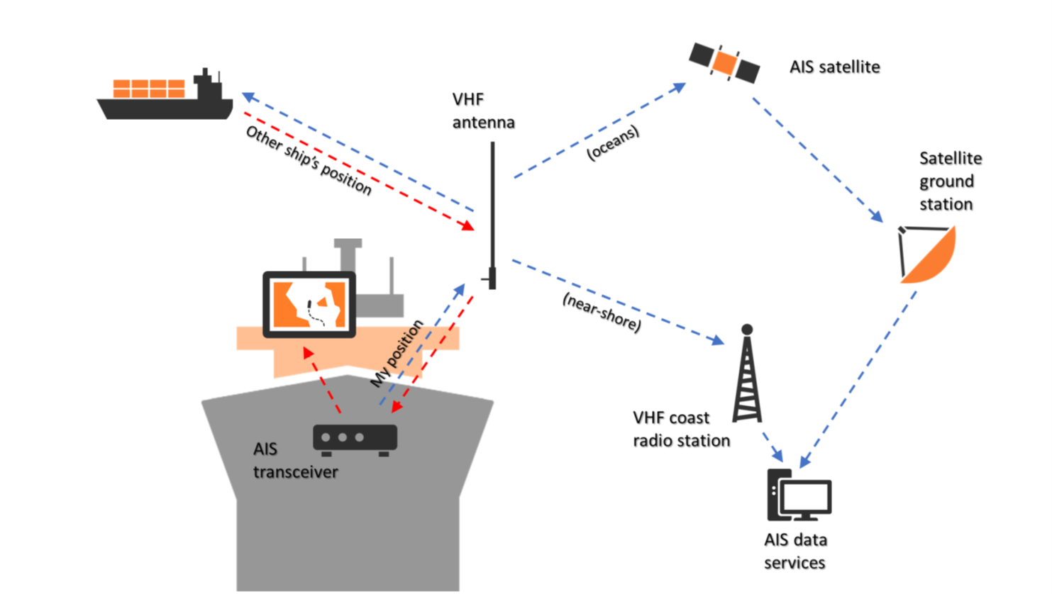

Slide 7
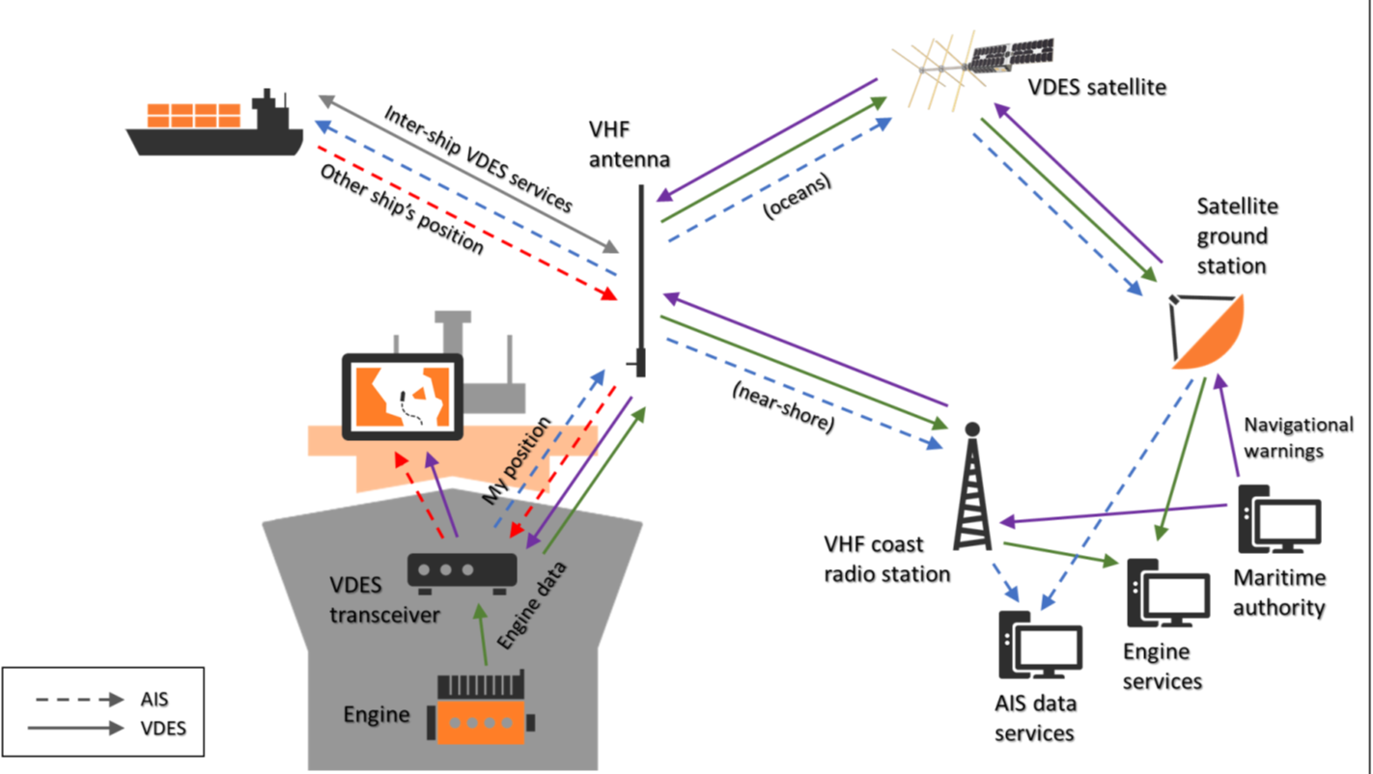

Slide 8
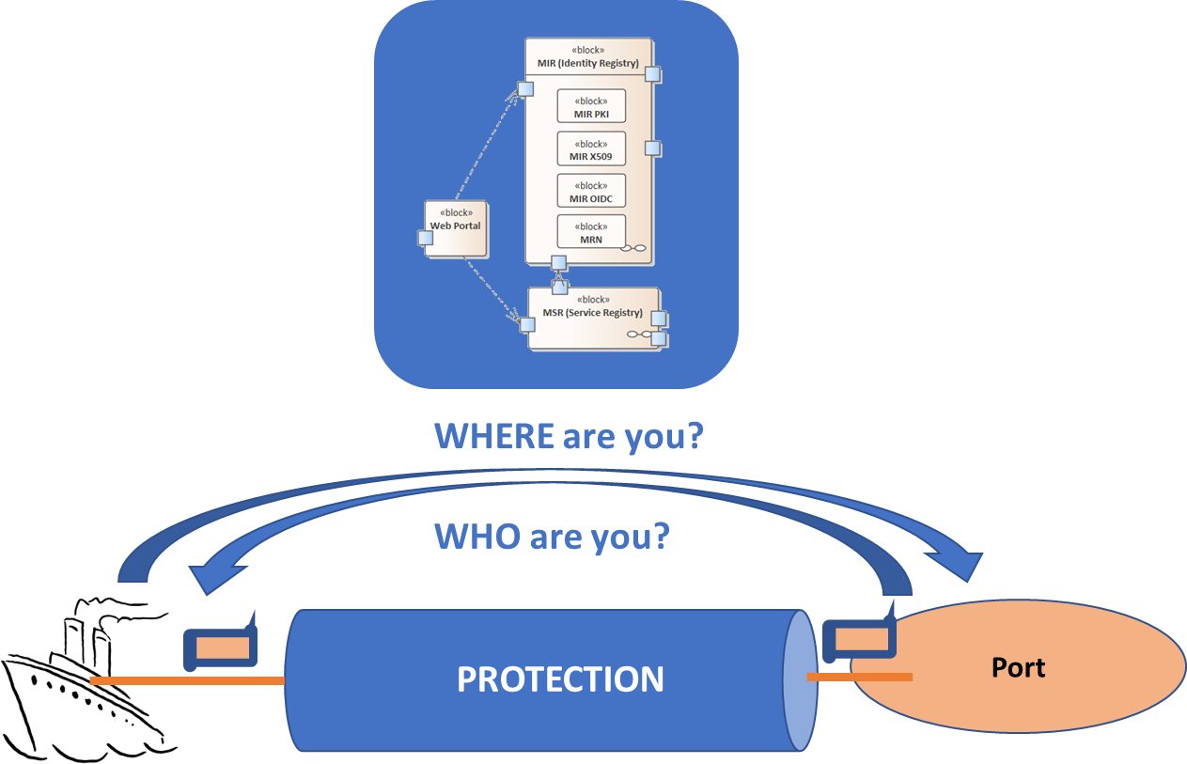
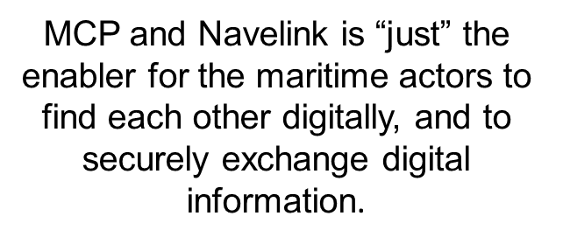
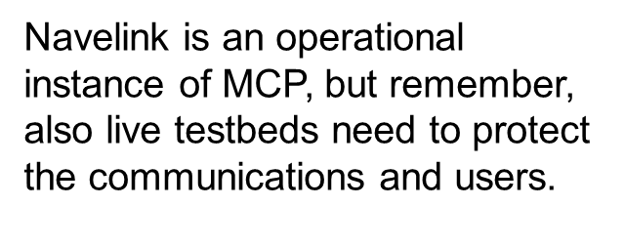
Maritime Connectivity Platform (MCP)
An MCP is the ‘enabler’ for digital maritime services

Slide 9
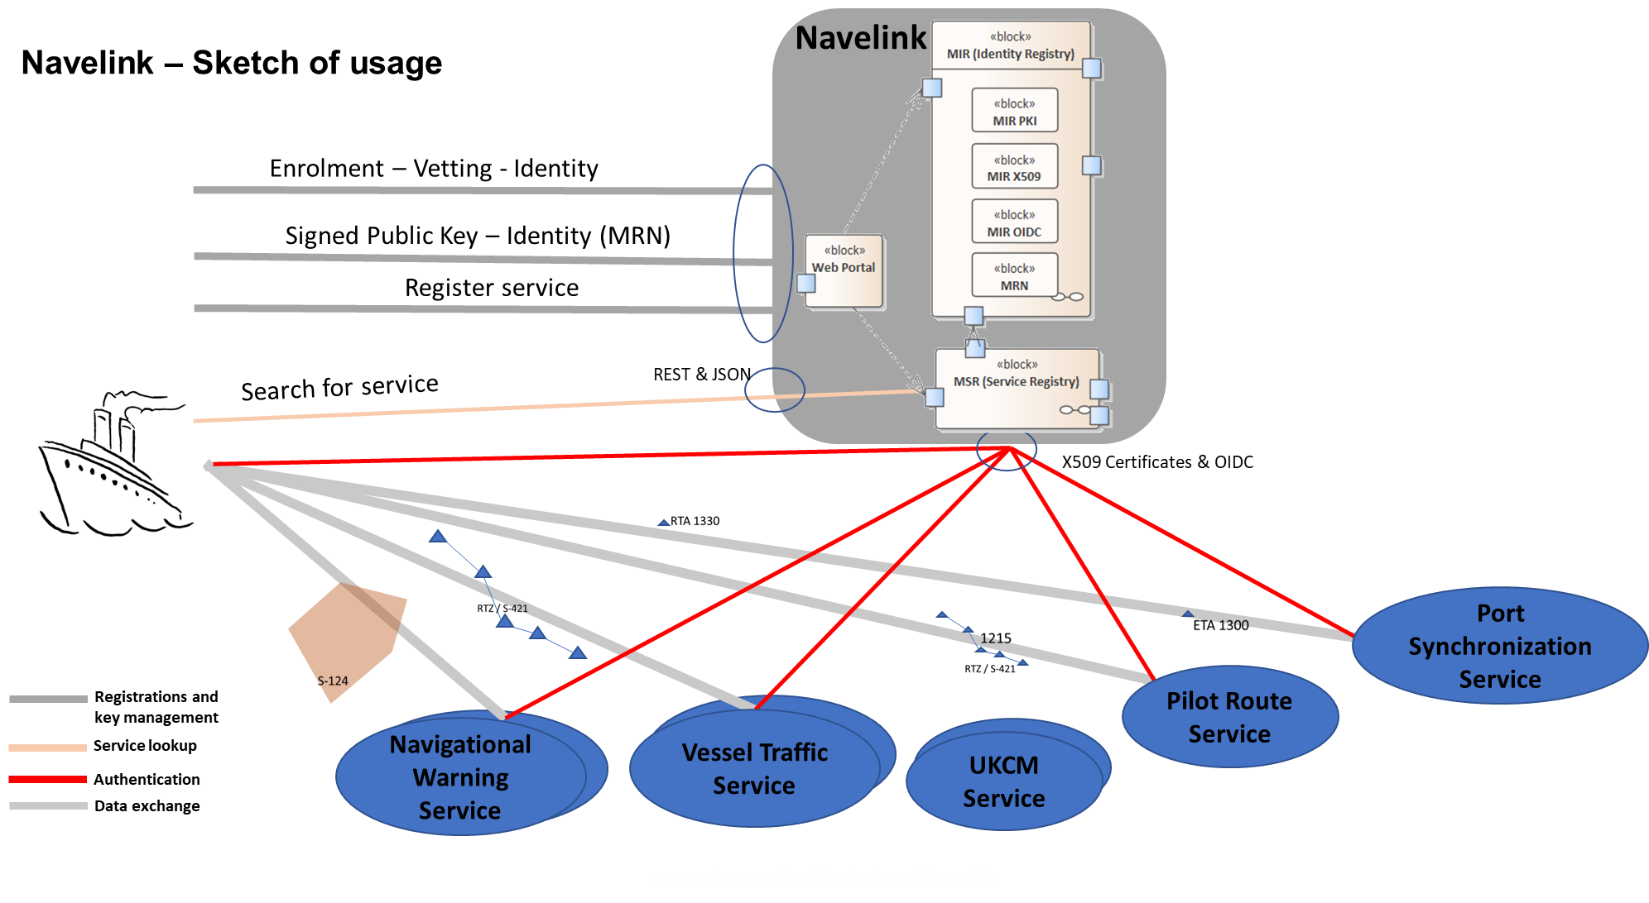

Slide 10
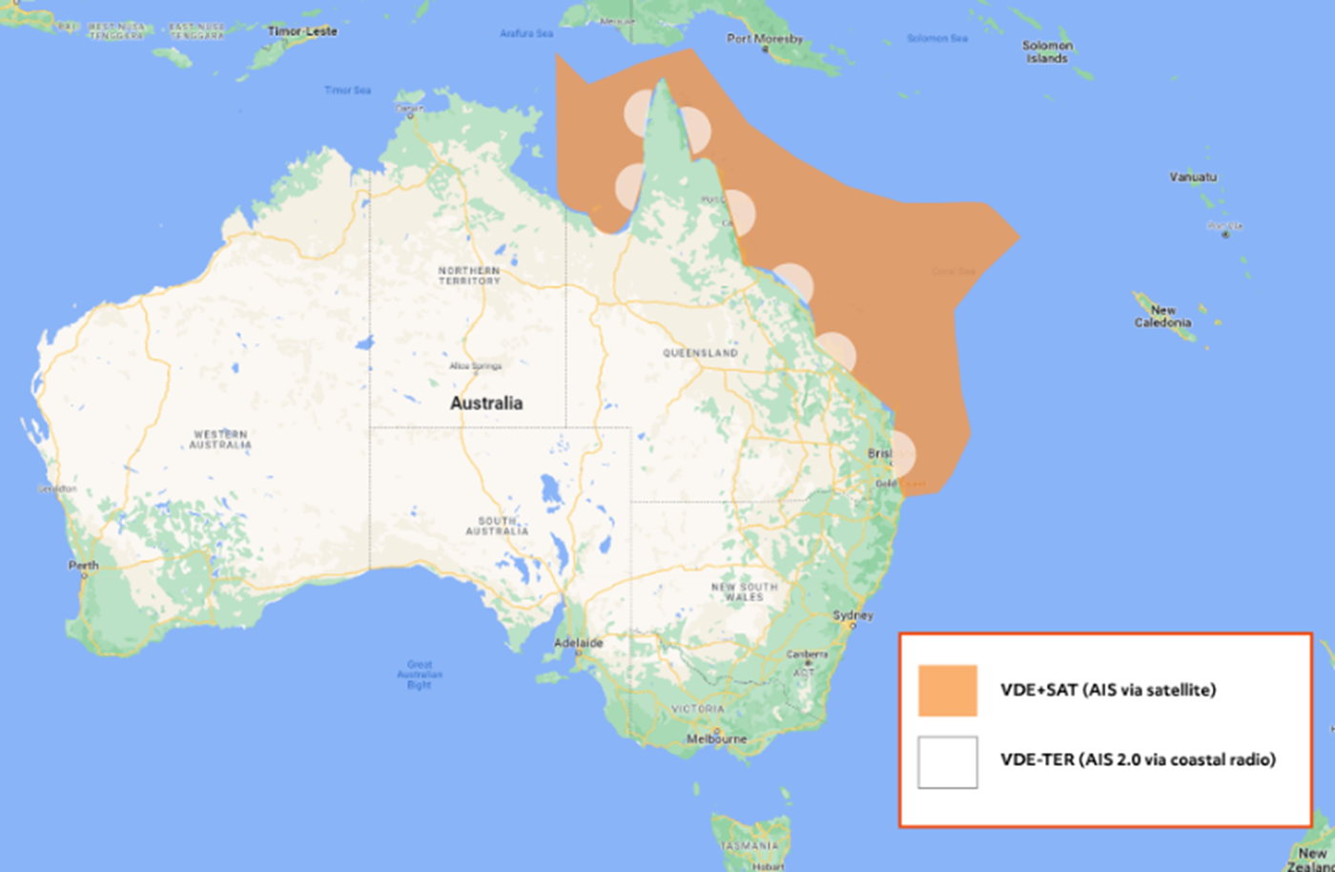
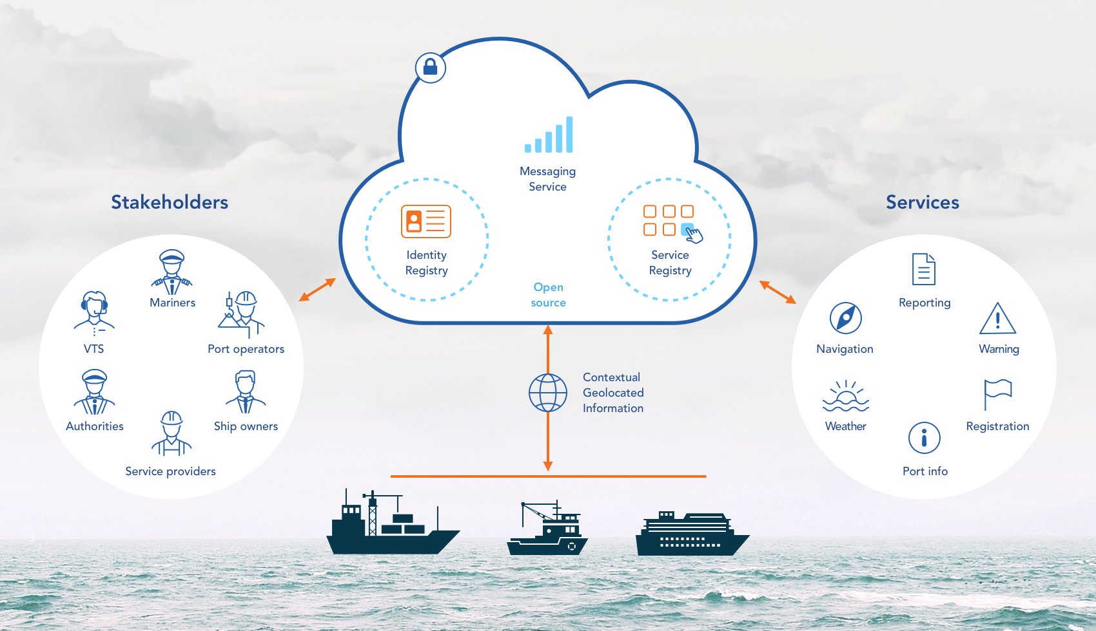
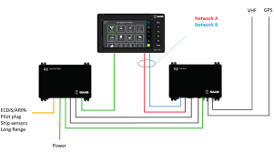
Worldwide AIS 2.0 Trial

